Slide 1
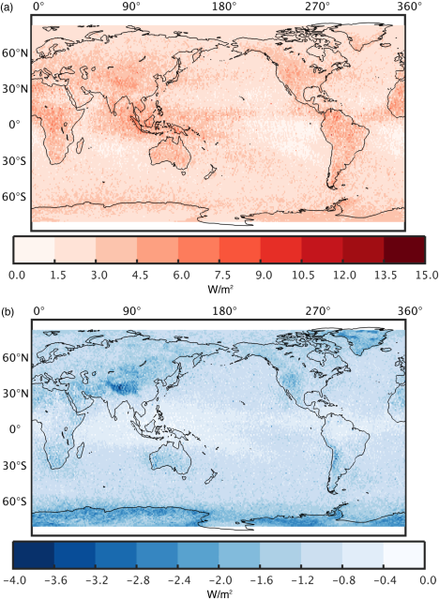
Neglecting LW Scattering Yields Significant ESM Biases
Absorption − Absorption & Scattering
The goal was to quantify the bias in Earth System Models from neglecting the known physics of multiple scattering from clouds in the infrared (longwave), which is typically done to reduce the computational expense of ESM radiative transfer.
TOA
This work found that the known physics of infrared multiple scattering is significant for Earth System Models and its neglect leads to a radiative transfer bias that is comparable to the radiative effect from doubling atmospheric carbon dioxide under clear-sky conditions.
Satellite-derived cloud products from CALIPSO, CloudSat, CERES, and MODIS CCCM are used to simulate a global map of radiative fluxes and heating rates with longwave scattering for the year 2010.
Results are analyzed relative calculations from a standard ESM radiative transfer routine: RRTMG_LW.
LW scattering decreases, on average, TOA flux by 2.6 W/m² and increases surface flux by 1.2 W/m². This represents 10% and 5% of the TOA and surface cloud radiative effect, respectively. The bias is concentrated at wavelengths between 20 and 28 μm.
Surface
Citation: Kuo, C.-P., Yang, P., Huang, X., Feldman, D., Flanner, M., Kuo, C., & Mlawer, E. J. (2017). Impact of multiple scattering on longwave radiative transfer involving clouds. Journal of Advances in Modeling Earth Systems, 9. https://doi.org/10.1002/2017MS001117

