Slide 1
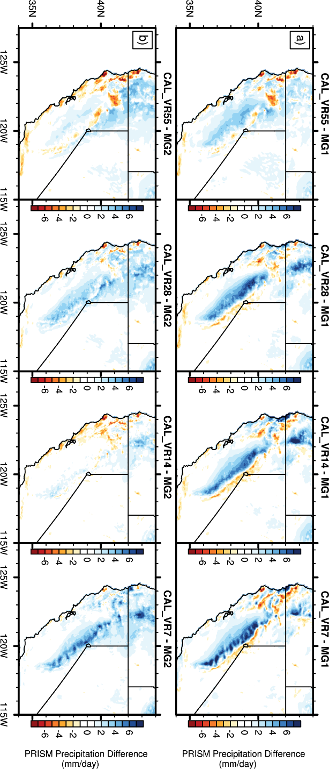
Sensitivity of Mountain Hydroclimate Simulations in Variable-Resolution CESM to Microphysics and Horizontal Resolution
An ensemble of variable-resolution CESM (VR-CESM) simulations across four resolutions (i.e., 55km to 7km) and two versions of the Morrison and Gettelman microphysics scheme were used to investigate their implications on simulated mountain hydroclimate variables in the California Sierra Nevada.
VR-CESM is a promising cutting-edge tool for global-to-regional downscaling, however, it has not been systematically evaluated across resolution and microphysics. This paper does this with a particular focus on hydroclimate variables that shape water management decisions.
Eight 16-year VR-CESM simulations were conducted over California.
Increasing model resolution to better resolve topography is insufficient for improving the mountain hydroclimatology.
The use of an updated microphysics scheme in combination with increased model resolution enhanced mountain windward/leeward distributions, spatial correlations were substantially improved and, importantly, snow water equivalent bias diminished by 9.4x, 4.9x, and 3.5x from 55 to 7km.
However, not all mountain processes improved and further investigation is required. In particular, a mountain cold-bias in two-meter surface temperature persisted and worsened with increasing model resolution.
Rhoades, A.M., P.A. Ullrich, C.M. Zarzycki, H. Johansen, S. Margulis, H. Morrison, Z. Xu, and W.D. Collins (2018) “Sensitivity of Mountain Hydroclimate Simulations in Variable-Resolution CESM to Microphysics and Horizontal Resolution” Journal of Advances in Modeling Earth Systems. https://doi.org/10.1029/2018MS001326

