Slide 1
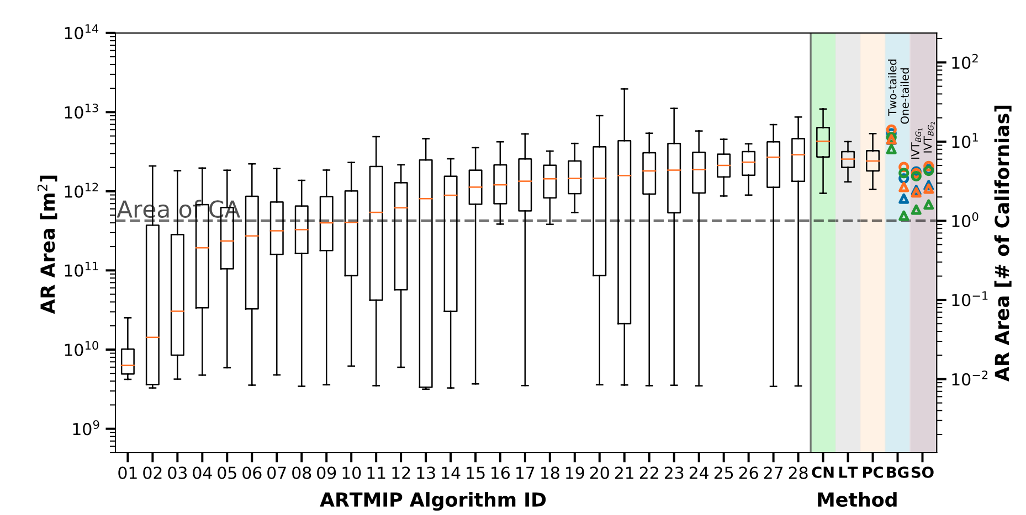
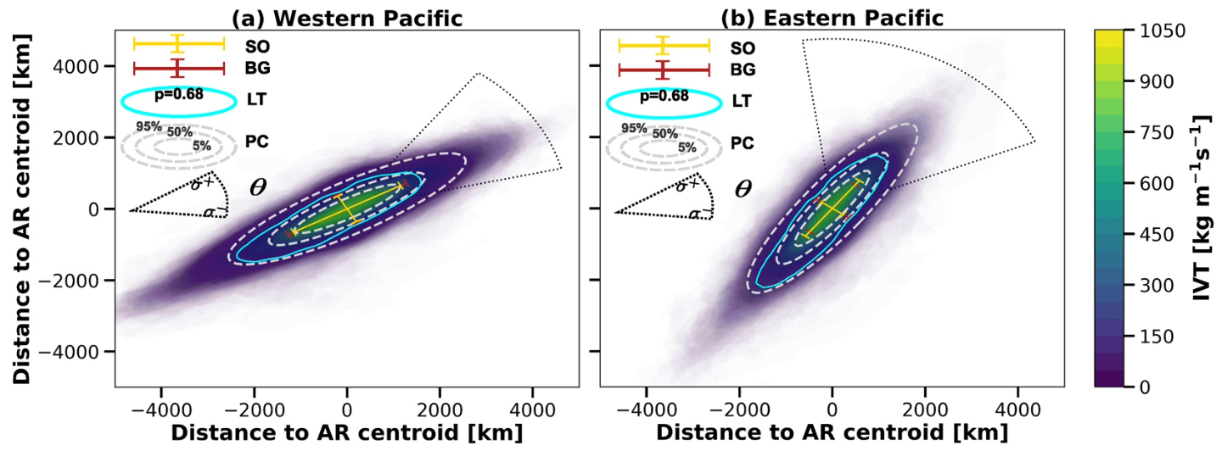

Constraining and Characterizing the size of Atmospheric Rivers: A perspective independent from the detection algorithm
Five novel methods for estimation of Atmospheric Rivers (AR) were developed in this work. These methods estimate the AR size independently of any detection algorithm. We managed to reduce the uncertainty and range in size estimation compared with the existing methods.
AR area estimation by ARTMIP algorithms (white background) and the novel five methods of this work (colored background).
The methods developed in this work result in a narrower range of AR size. Moreover, they provide objective way to estimate AR size independently from the detection algorithm, which can help for evaluating the AR size change (area, length, width) in future climate change scenarios.
Develops independent 5 size estimation methods:
  Principal Component Analysis of Integrated Vaport Transport (IVT) (PC)
  Statistical Overlapping with background IVT PDF (SO)
  Kolmovorov-Smirnoff test of AR composite IVT and background field (BG)
  Lagrangian tracers simulation to estimate AR area (LT)
  Hand-labeled AR using ClimateContours tool from LBL-developed ClimateNet software (CN)
Uses a fast, robust probability estimation method (the LBL-developed fastKDE) to create Probability Density Functions, Conditional Probability Distributions, and Bivariate PDFs.
Summary and illustration of the five methods used in this work, for the AR generated in the northwestern vs northeastern Pacific ocean.
Inda-Díaz, H. A., O'Brien, T. A., Zhou, Y., & Collins, W. D. (2021). Constraining and Characterizing the size of Atmospheric Rivers: A perspective independent from the detection algorithm. Journal of Geophysical Research: Atmospheres, 126, e2020JD033746. https://doi.org/10.1029/2020JD033746, Accepted

