Slide 1
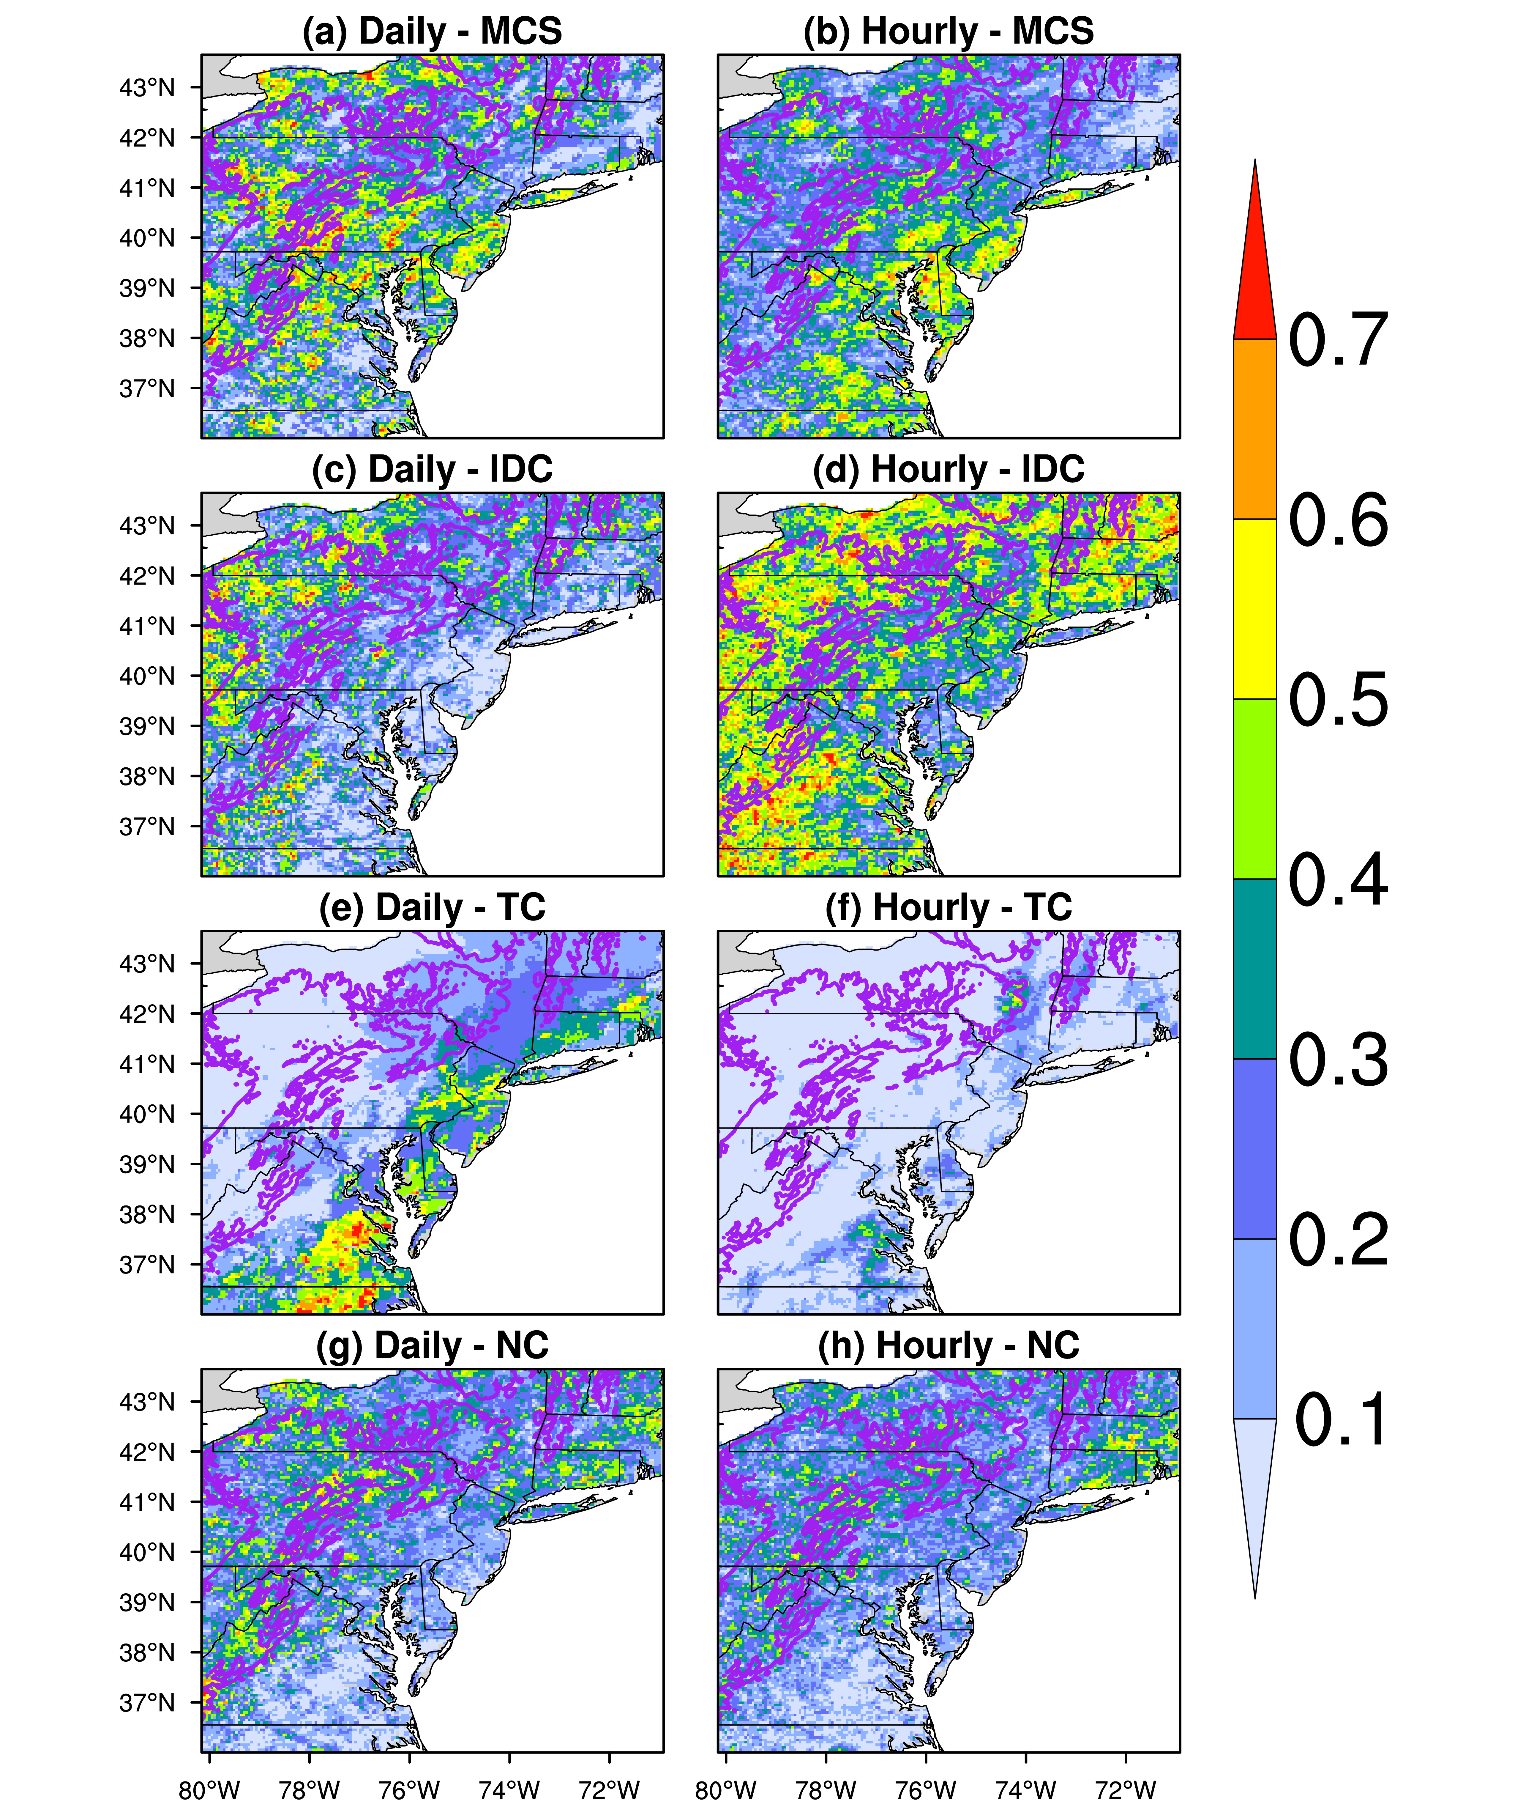
The Contributions of Rainfall Systems to Mid-Atlantic Summer Extreme Precipitation
Objective
Investigate the contributions of four types of precipitation—mesoscale convective system (MCS), isolated deep convection (IDC), tropical cyclone (TC), and non-convective (NC)—to summer mean and extreme precipitation over the Mid-Atlantic region.
Approach
Combine a newly developed MCS/IDC dataset with a TC dataset to classify different types of precipitation (MCS, IDC, TC, and NC).
Quantify the climatological characteristics of the four types of precipitation and their contributions to summer mean and extreme precipitation for 2004–2017 over the Mid-Atlantic region.
Classify MCS and IDC events into 5 groups based on their initiation locations and identify their relative contributions to Mid-Atlantic precipitation.
Impact
Established that MCS, IDC, and NC make essential contributions to the Mid-Atlantic summer mean and extreme precipitation.
Revealed that ~50% of MCSs in the Mid-Atlantic region originate from the Great Plains and Midwest.
Provides a foundation for understanding how summer mean and extreme precipitation in the Mid-Atlantic region may respond to human perturbations.
Highlights the need to develop an understanding of the remote influence of MCSs on Mid-Atlantic extreme precipitation and investigating the specific relationships of each storm type with large-scale meteorological patterns.
Distributions of the fractional contribution of different precipitation types to extreme precipitation. MCS dominates summertime extreme daily and hourly precipitation in the central Mid-Atlantic coastal areas. IDC has larger contributions at an hourly than at a daily scale.
Li, J., Y. Qian, L. R. Leung, and Z. Feng. “Summer mean and extreme precipitation over the Mid-Atlantic region: climatological characteristics and contributions from different precipitation types.” J. Geophys. Res.-Atmos., 126, e2021JD035045, (2021). [DOI: 10.1029/2021JD035045].

