Slide 1
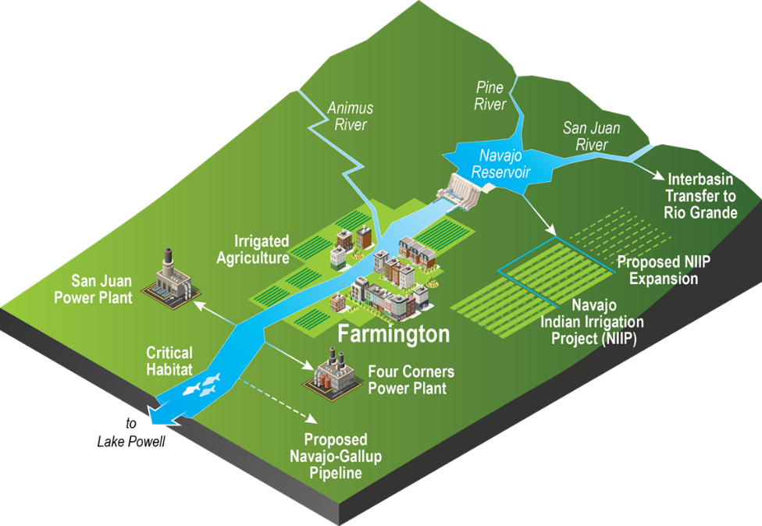
Quantifying Decision Uncertainty in Water Management with a Coupled Model
Objective
Develop a new model that quantifies the role of risk perception in water management decisions and that can be upscaled to regional domains.
Approach
Established information exchange between a decision-making model and a hydrologic process model.
Used statistical mapping to quantify how farmers make water management decisions.
Modeled how farmer behavior is affected by changing natural socioeconomic conditions.
Impact
Improves on rule-based risk decision making by considering the influences of past experiences and new information.
Shows that farm location will affect farmers’ risk perception regarding water availability and further influence their choices about irrigation area expansion.
Researchers at Lehigh University, Sandia, and NREL developed a coupled model that can more accurately quantify the dynamics of human decision-making processes in the context of water management.
Hyun JY, SY Huang, YCE Yang, V Tidwell, and J Macknick. 2019. “Using a Coupled Agent-Based Modeling Approach to Analyse the Role of Risk Perception in Water Management Decisions,” Hydrology and Earth System Science, 23:2261-2278. DOI: 10.5194/hess-23-2261-2019.
Notes:
http://www.pnnl.gov/science/highlights/highlights.asp?division=749

