Slide 1
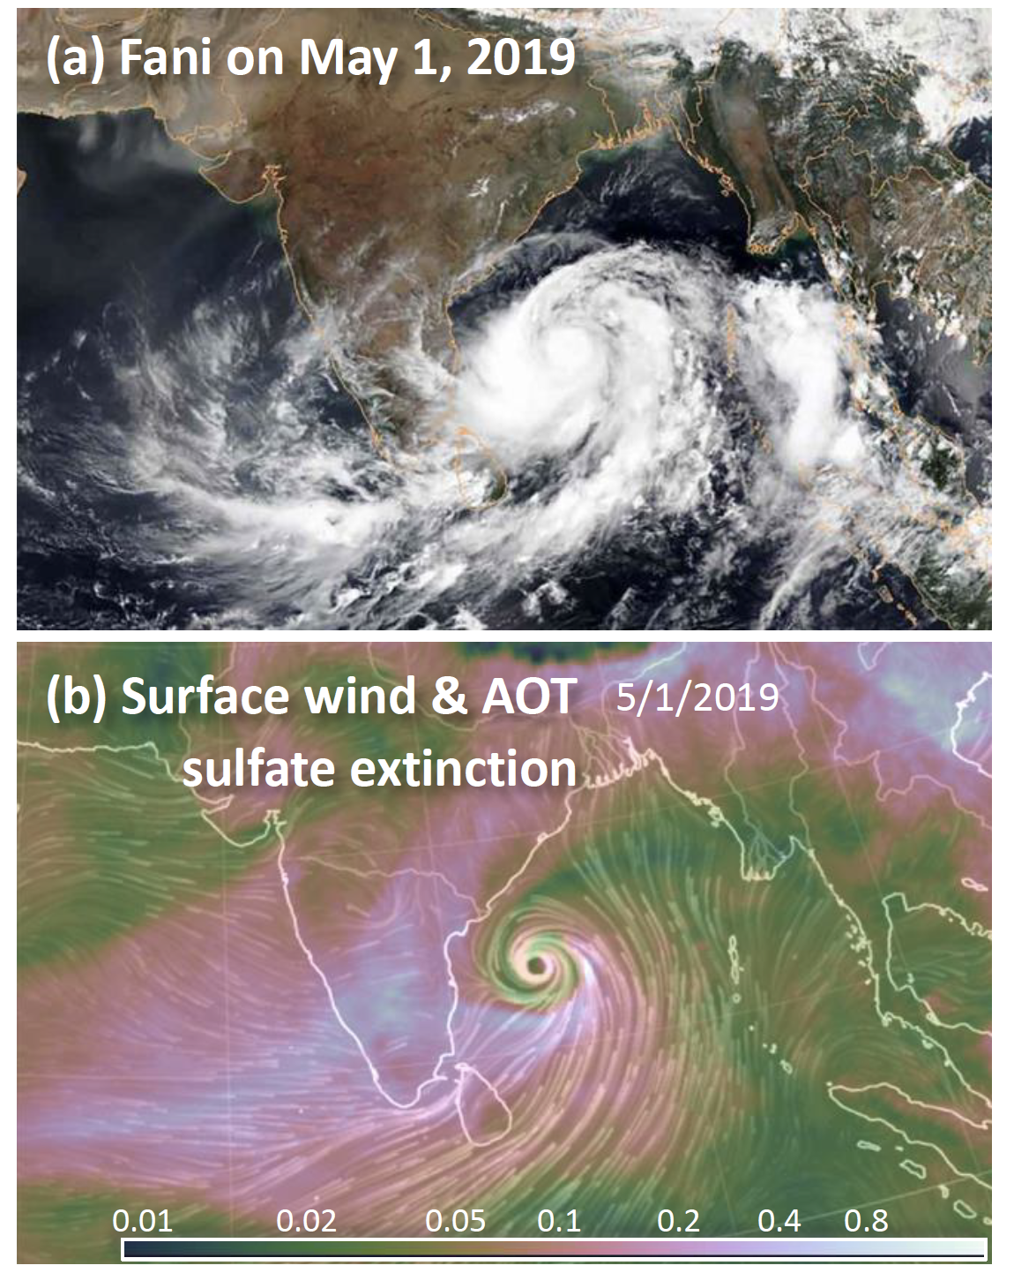

Does aerosol fuel or extinguish a super cyclone?
Cyclone Fani was an intense storm and it caused a high casualty. Analyzing the opposite effects of heat and aerosol on Fani shows that climate warming has overcome the negative effect of aerosol on intensifying tropical cyclones.
Fani developed within a high concentration of aerosols over the abnormally warm ocean, thereby presenting an opportunity to understand the compound effects of aerosols and regional warming on a tropical cyclone. The result lends support to the 2020 Super Cyclone Amphan, the strongest cyclone in the Bay of Bengal.
a quantitative attribution analysis was conducted using the WRF-Chem at the convection-permitting grid spacing;
removal of tropospheric warming shows approximately twice as strong an effect on Fani as that of SST warming;
aerosol and its interaction with the atmosphere acted to mitigate the strengthening effect of anthropogenic warming on Fani, but was not strong enough to entirely counteract it;
was reported in the news (WSJ, CBS, The Tribune, The Independence)
DOI:10.1088/1748-9326/ab91e7
Zhao, L., S.-Y. Wang, E. Becker, J.-H. Yoon, and A. Mukherjee, 2020: Cyclone Fani: The tug-of-war between regional warming and anthropogenic aerosol effects. Environmental Research Letters, (accepted)

