Slide 1
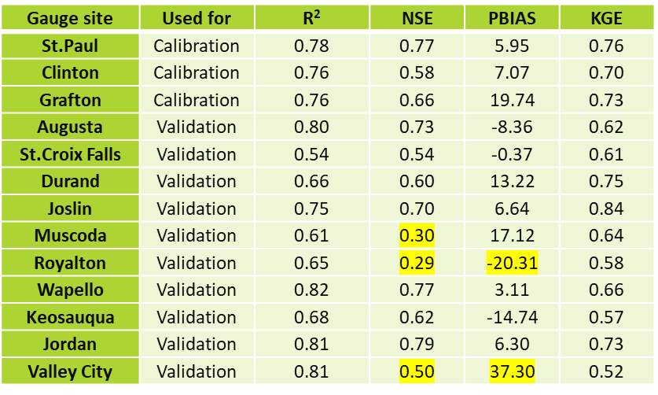
Monthly streamflow statistics for Upper Missippi River Basin (umrb) SWAT model calibration and validation gauge sites.
The vast majority of the calibration and validation statistics (Table 1) met or exceeded proposed satisfactory model criteria except for the five values highlighted in yellow. Those included two weak Nash-Sutcliffe Efficiency (NSE) for two northern sites (Muscoda and Royalton) and two PBIAS values > 20%.
The statistics reported in the table along with further statistical analyses confirmed that the PRISM climate data/HG PET method, and Livneh climate data/HG PET method resulted in accurate UMRB streamflow predictions in SWAT. However, NCDC climate data resulted in distinctly weaker streamflow results and thus is not recommended for further analyses.
A spatial validation approach was used to calibrate and validate the SWAT UMRB simulations conducted from 1983 to 2005, which were obtained using the Livneh climate data and HG PET method.
The St.. Paul (MN), Clinton (IA) and Grafton (IL) gauge sites were selected for the calibration sites. The other 10 gauge sites were used validate streamflow without any further adjustment of the calibrated input parameters.
Chen, M., P.W. Gassman, R. Srinivasan, Y. Cui and R. Arritt. 2020. Analysis of alternative climate datasets and evapotranspiration methods for the Upper Mississippi River Basin using SWAT within HAWQS. Science of the Total Environment. 720: 137562. Doi: 10.1016/j.scitotenv.2020.137562.

