Slide 1
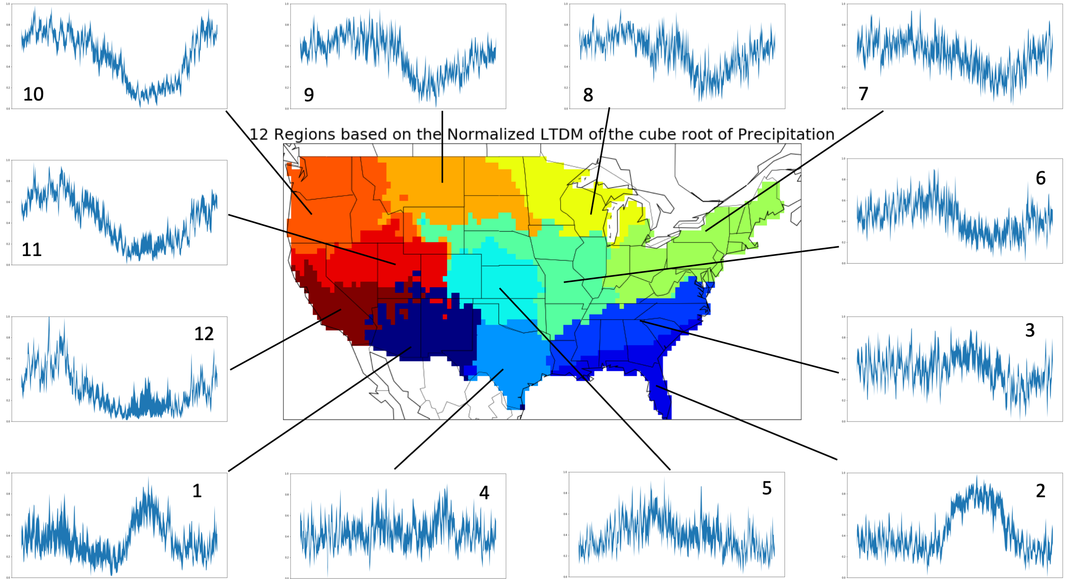

Using Self-Organizing Maps to Identify Coherent CONUS Precipitation Regions
The shape of the annual cycle of precipitation can be used to create spatially coherent regions with an artificial neural network in a new and objective way.
These regions strike a balance between containing many events and containing only similar events when aggregating extreme precipitation.
12 regions created from long term daily means, LTDMs of the cube root of precipitation, scaled to vary from 0 to 1, at each grid point. The side plots show representative LTDMs of the cube root of precipitation on the Y axis. The middle 50% of grid points in each region are contained in the shaded area of each side plot. Side plots each begin at Jan 1st on the left and end on Dec 31st on the right.
This objective method yields regions that have several key differences to popular, subjectively chosen, precipitation regions.
The number of regions is a tunable parameter but novel criteria for choosing the most appropriate number of regions are a key innovation.
A kind of artificial neural network called a Self-Organizing Map is trained on the annual cycle of precipitation.
Multiple novel criteria assess different properties of candidate regions (such as: compactness, connectedness, and robustness) to find the optimal number of regions for a particular dataset.
Swenson, L. M., and R. Grotjahn, 2019: Using Self-Organizing Maps to Identify Coherent CONUS Precipitation Regions. J. Climate, 32, 7747–7761, DOI: ﻿10.1175/JCLI-D-19-0352.1

