Slide 1
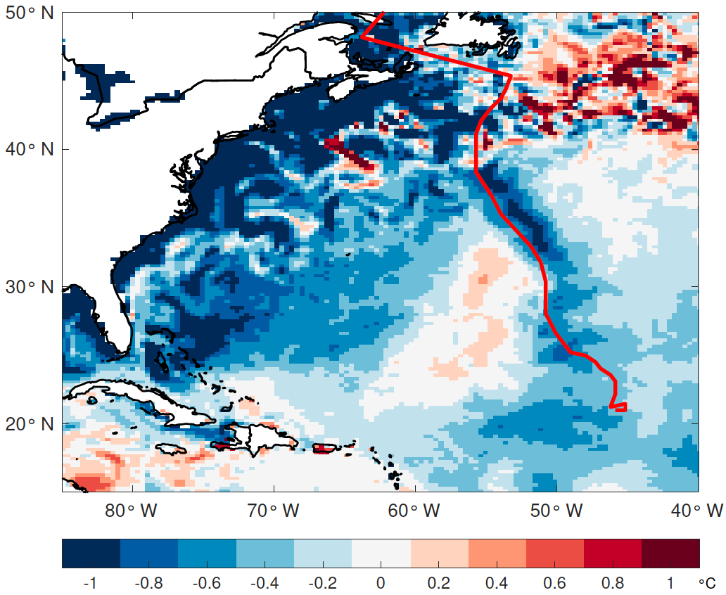

The Influence of Atmosphere–Ocean Coupling on Simulated and Projected Tropical Cyclone Precipitation
Scientific Challenges
A hurricane track (red line) its cold wake (represented by the difference in sea surface temperature for the period after hurricane passage minus before hurricane passage, shaded, °C) simulated by the coupled HadGEM3-GC31-HM model at 50 km resolution.
Global climate model (GCM) simulations have large uncertainties in future projections of tropical cyclone (TC) precipitation. It remains unclear to what extent atmosphere–ocean interactions influence simulated and projected TC precipitation.
Approach and Results
We used multi-model ensembles from the HighResMIP project and compared simulations from fully coupled atmosphere–ocean GCMs and atmosphere-only GCMs over 1950–2050. Results show that TC precipitation is largely modulated by atmosphere–ocean coupling.
Significance
Ocean coupling generally leads to decreased TC precipitation over both ocean and land.
Large-scale sea surface temperature biases and TC cold wakes, key facets of ocean coupling, drive the reduction in simulated precipitation in coupled relative to atmosphere-only simulations.
Projected future TC precipitation increases in most regions, however the magnitude can vary by a factor of 3 depending on ocean coupling.
Huang, H., Patricola, C.M., & Collins, W.D. (2021). The influence of ocean coupling on simulated and projected tropical cyclone precipitation in the HighResMIP-PRIMAVERA simulations. Geophysical Research Letters, 48, e2021GL094801. DOI: 10.1029/2021GL094801

