Slide 1
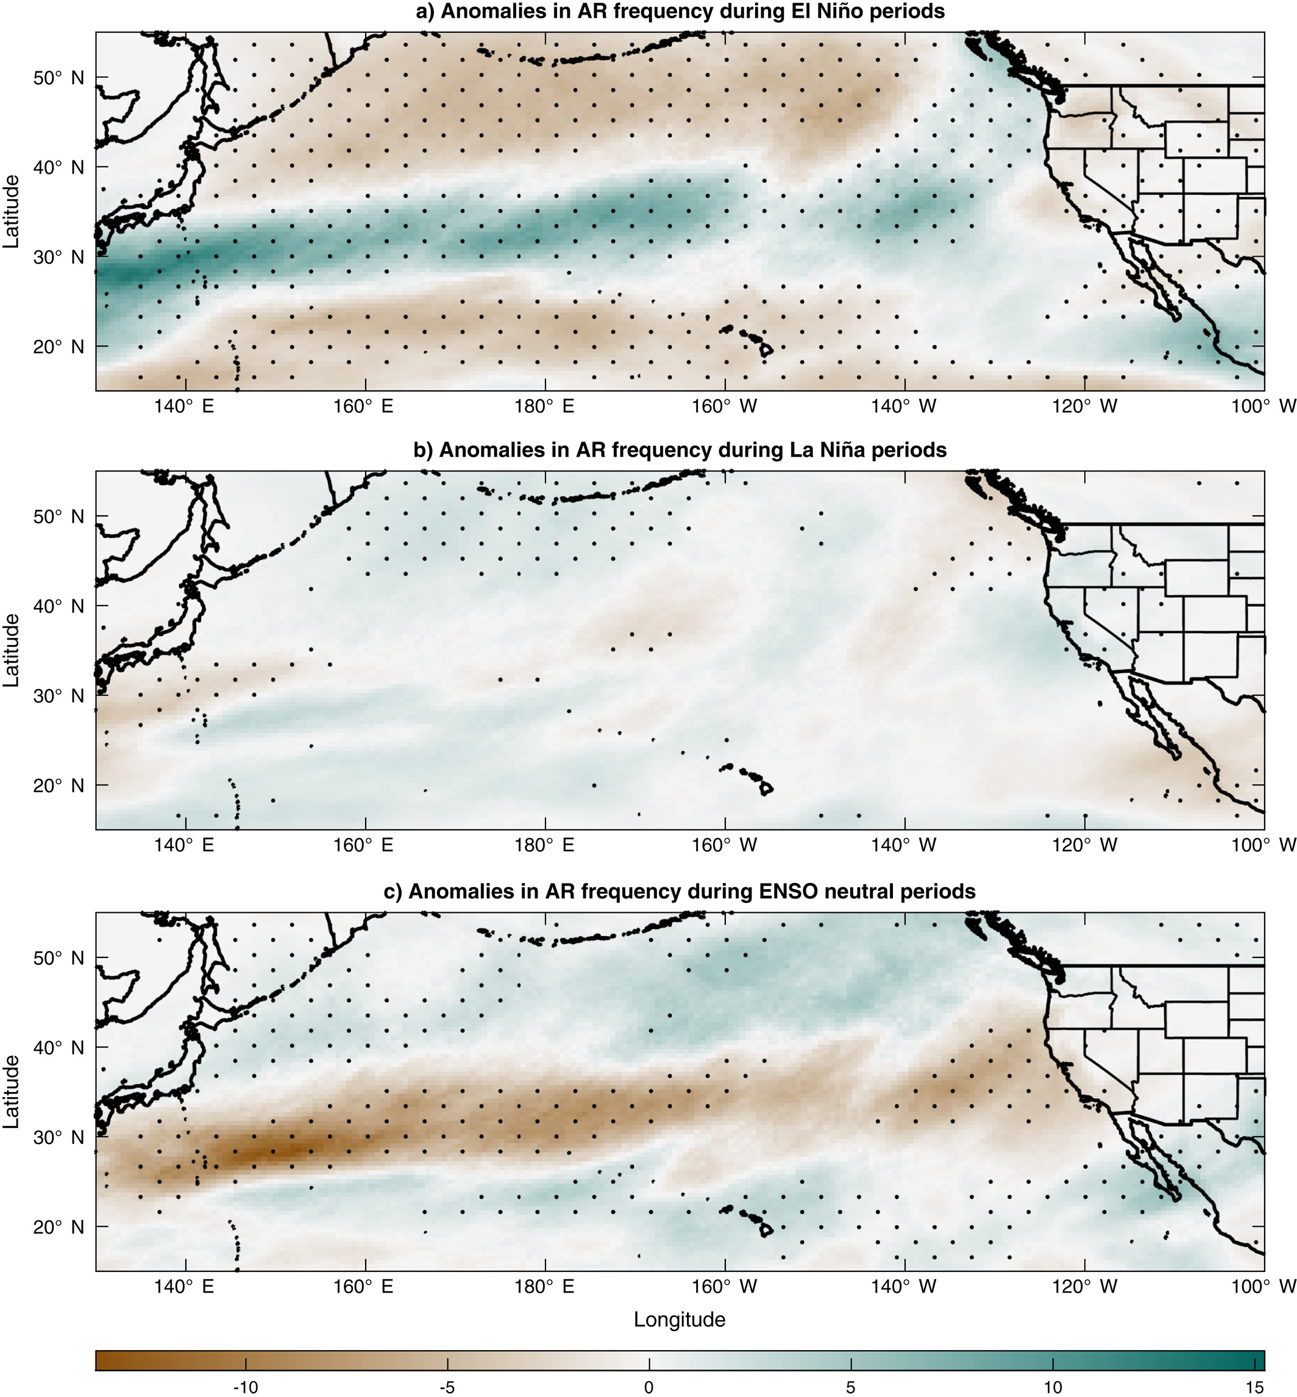

Sources of Subseasonal‐To‐Seasonal Predictability of Atmospheric Rivers and Precipitation in the Western United States
Figure. Spatial patterns of anomalies in the Weather Research and Forecast (WRF) model‐simulated atmospheric river (AR) frequency (number of time steps season⁻¹ in relative to winter climatology) during three phases of the El Niño/Southern Oscillation (ENSO)
Scientific Challenges
Atmospheric rivers (ARs) produce much winter precipitation in the western US. Yet accurate predictions of ARs and precipitation remain challenging. One barrier is we don’t fully understand the impacts of climate variability on western US hydroclimate. The barrier limits predictive skills of regional ARs and precipitation.
Approach and Results
We used a large ensemble of regional climate model simulations 1981–2017 to assess the sources of predictability of ARs and precipitation in the western US. Results show that the El Niño/Southern Oscillation and Madden‐Julian Oscillation are important sources of predictability of western US hydroclimate.
Significance
The El Niño/Southern Oscillation (ENSO)‐atmospheric river (AR) relationship depends on ENSO index, with enhanced landfalling AR activity during extreme El Niño
Madden‐Julian oscillation (MJO) leads to significant landfalling AR and precipitation anomalies in large‐ensembles, but observations are too short to show this signal
ENSO modulates the MJO‐AR relationship, thus consideration of concurrent climate modes could improve seasonal hydroclimate prediction
Huang, H., Patricola, C. M., Bercos-Hickey, E., Zhou, Y., Rhoades, A., Risser, M. D., & Collins, W. D. (2021). Sources of subseasonal-to-seasonal predictability of atmospheric rivers and precipitation in the western United States. Journal of Geophysical Research: Atmospheres, 126, e2020JD034053. DOI: 10.1029/2020JD034053

