Slide 1
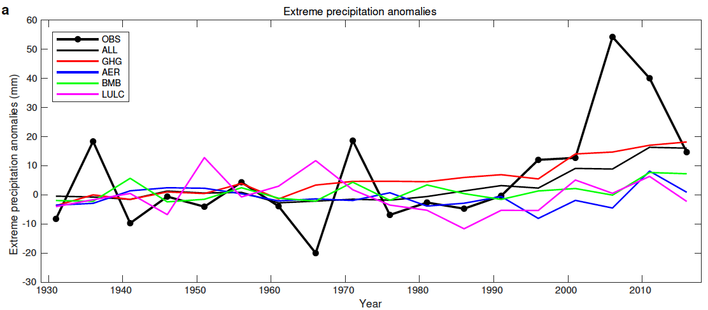

Rise in Northeast US Extreme Precipitation Caused by Atlantic Variability and Climate Change
Scientific Challenges
Figure. Extreme precipitation anomalies over the Northeastern US in the GHCN-D observations (OBS), CESM1 historical all-forcings (ALL) and single forcing simulations (GHG: greenhouse gases, AER: aerosols, BMB: biomass burning, and LULC: land use and land cover), all represented by non-overlapping 5-year means and relative to 1929–1958.
Extreme precipitation (EP, defined as precipitation falling in the heaviest 1% of wet days) in the Northeastern US increased abruptly after 1996. This increase coincided with warming Atlantic sea surface temperatures (SSTs). Yet the causes underlying the 1996 EP shift remain unclear.
Approach and Results
We used a large ensemble of climate simulations and an optimal fingerprint method to separate the roles of internal variability and external forcings on the observed changes of North Atlantic SSTs and Northeast EP. Results show that external forcings have significantly affected both Northeast EP and North Atlantic SSTs.
Significance
Greenhouse gases are the only anthropogenic forcing exerting substantial influence on EP, first detected in 2008.
The warming of North Atlantic SSTs since 1990s is attributable to internal variability of the Atlantic, anthropogenic aerosols and greenhouse gases. They altogether may lead to the anomalously high EP through inducing more tropical cyclone EP events over the Northeast.
We attribute the 1996 EP shift to both unforced Atlantic variability and anthropogenic forcings.
Huang, H., Patricola, C.M., Winter, J.M., Osterberg, E.C., & Mankin, J.S. (2021) Rise in northeast US extreme precipitation caused by Atlantic variability and climate change. Weather and Climate Extremes, 33, 100351. DOI: 10.1016/j.wace.2021.100351

