Slide 1
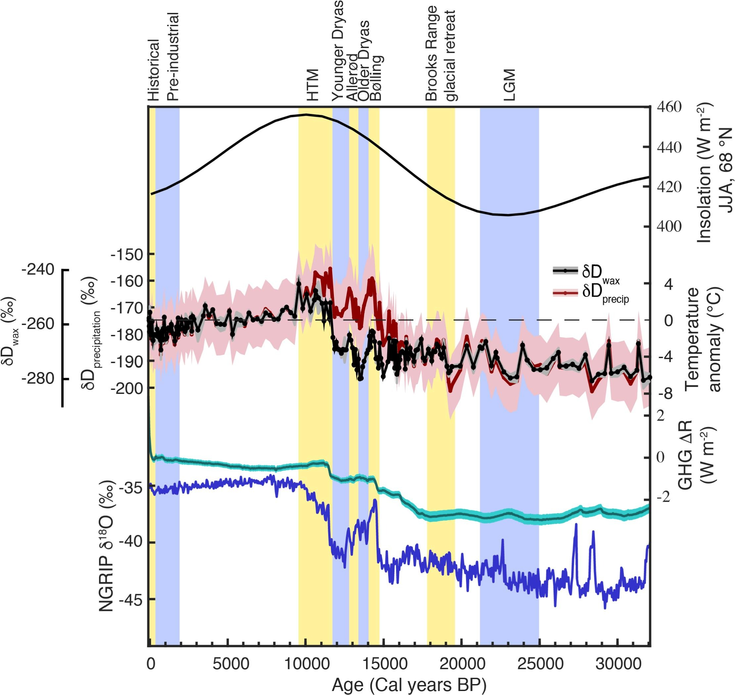
Lacustrine leaf wax hydrogen isotopes indicate strong regional climate feedbacks in Beringia since the last ice age
Objective: The Late-Quaternary climate of Beringia remains unresolved despite the region's role in modulating glacial-interglacial climate and as the likely conduit for human dispersal into the Americas. Here, we investigate Beringian temperature change using an ∼32,000-year lacustrine record of leaf wax hydrogen isotope ratios (δ²H_{wax}) from Arctic Alaska. Based on Monte Carlo iterations accounting for multiple sources of uncertainty, the reconstructed summertime temperatures were ∼3 °C colder (range: −8 to +3 °C) during the Last Glacial Maximum (LGM; 21-25 ka) than the pre-industrial era (PI; 2–0.1 ka).
Approach: Here Lake core form Lake E5, located in Alaska's North Slope is used to construct the climate and CCSM simulations are used to verify controlling processes.
Results/Impacts: Our reconstruction, together with climate modeling experiments, indicates that Beringia responds more strongly to North Atlantic freshwater forcing under modern-day, open-Bering Strait conditions than under glacial conditions. Furthermore, a 2 °C increase (Monte Carlo range: −1 to +5 °C) over the anthropogenic era reverses a 6 °C decline (Monte Carlo range: −10 to 0 °C) through the Holocene, indicating that recent warming in Arctic Alaska has not surpassed peak Holocene summer warmth.
Figure 1 A comparison between summer (JJA) insolation (Laskar et al., 2004), Lake E5 δ²H_{wax} (black) and inferred δ²H_{precipitation} and temperature anomalies with 75% and 25% confidence bounds shown for temperature estimates (red with pink shading), relative greenhouse gas radiative forcing from CO₂, CH₄, and N₂O (Köhler et al., 2017), and the NGRIP δ¹⁸O record (Andersen et al., 2004). (For interpretation of the references to colour in this figure legend, the reader is referred to the Web version of this article.)
Daniels, W. C., J. M Russell1, C. Morrill, W. M. Longo, A. E. Giblin, P. Holland-Stergar, J. M. Welker, X. Wen, A. Hu, Y. Huang, 2021: Lacustrine leaf wax isotopes reveal strong regional climate feedbacks in Beringia since the last ice age, Quaternary Science Reviews, 269, 107130.

