Slide 1
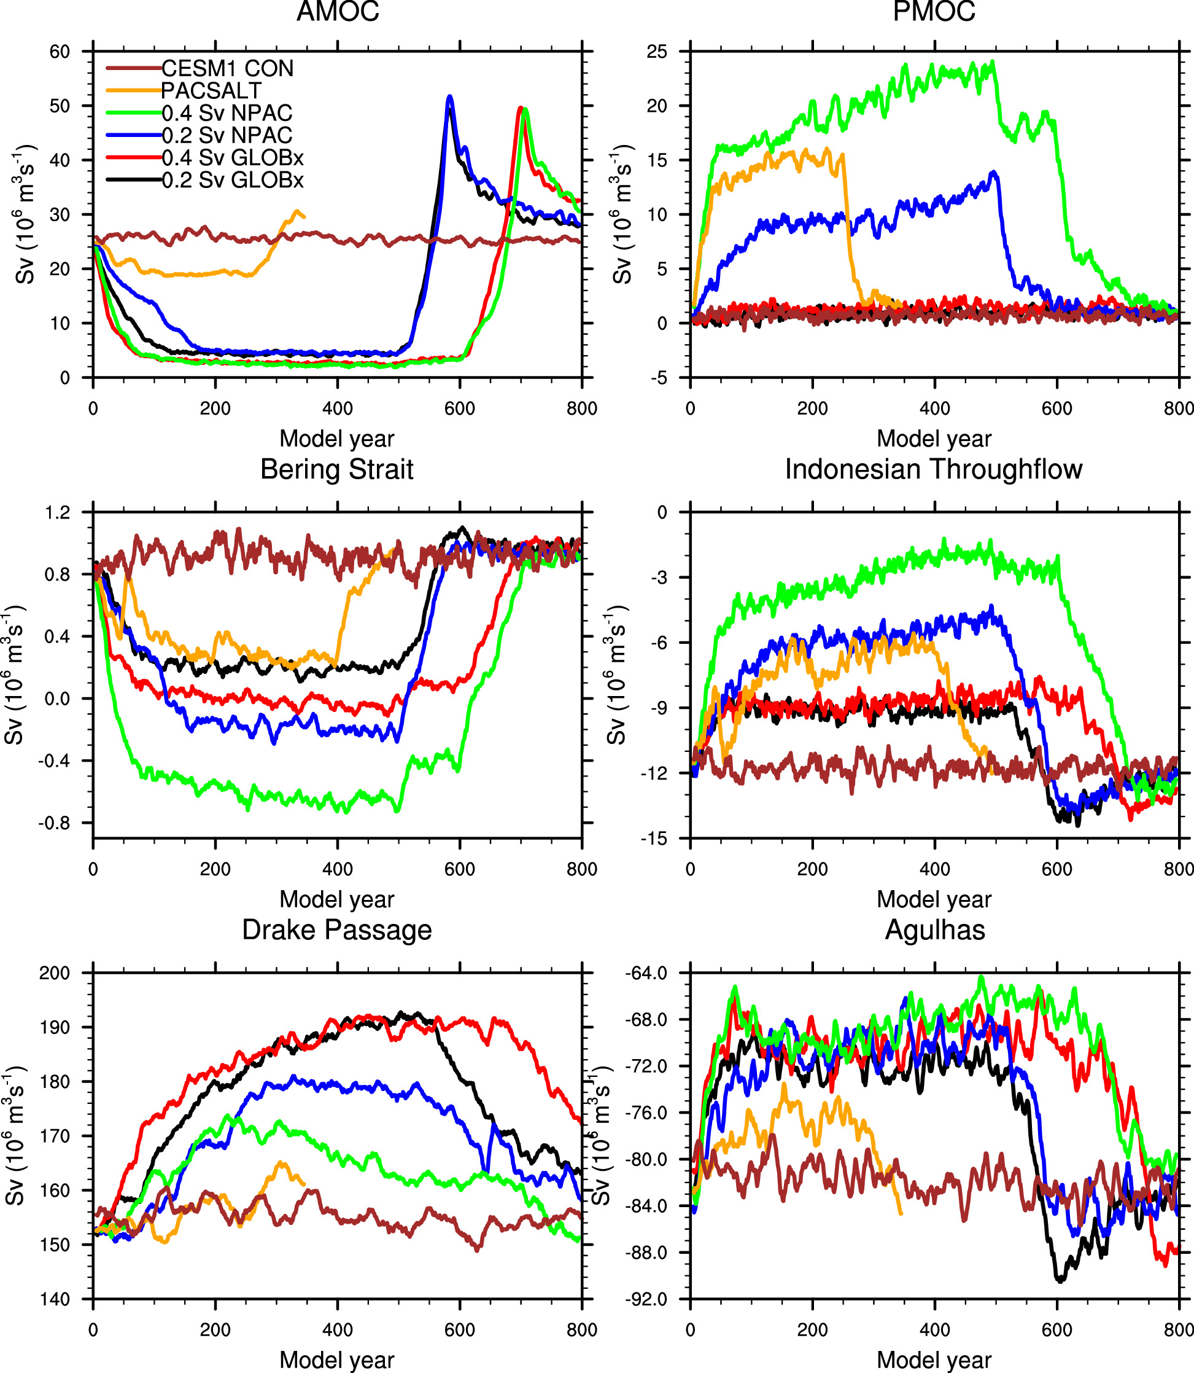
The Influence of Variability in Meridional Overturning on Global Ocean Circulation
Objective: The Atlantic meridional overturning circulation (AMOC) is an important global-scale circulation and changes in AMOC can induce significant regional and global climate impacts. Here we study the stability of AMOC and its influence on global ocean circulation and the surface climate though analyzing a set of sensitivity experiments using the Community Earth System Model version 1 (CESM1).
Approach: Here 5 specifically design experiments are carried out using CESM1 and compared with CESM1 PI control run.
Results/Impacts: Our results indicate that significant changes in AMOC affect ocean circulation not only in the Atlantic basin, but also globally. For example, a collapsed AMOC weakens the Bering Strait and Indonesian throughflows and the Agulhas Current, but strengthens the ACC (measured as the Drake Passage transport). The collapse of AMOC would not automatically cause a strengthening of the PMOC unless additional salt flux is added into the subpolar North Pacific under modern conditions. This is due to two reasons: 1) a much higher precipitation (thus higher net freshwater input) in the subpolar North Pacific than that in the subpolar North Atlantic and 2) the weaker AMOC inducing a weakening (even reversing direction) of the Bering Strait throughflow, which leads to a reduced freshwater being transported into the Atlantic from the North Pacific via the Bering Strait (and thus more freshwater being kept in the subpolar North Pacific), leading to a much fresher surface water that prevents the deep convection to occur.
Figure 1 Time evolution of the AMOC and PMOC, and the transports of key straits: Bering Strait, Indonesian Throughflow, Drake Passage, and the Agulhas Current. Here positive numbers represent eastward (northward) flow and negative numbers represent westward (southward) flow.
Hu, A., G. A. Meehl, N. Rosenbloom, M. J. Molina, W. G. Strand, 2021, The influence of variability in meridional overturning on global ocean circulation, J. Climate, 34, 7697-7716.

