Slide 1
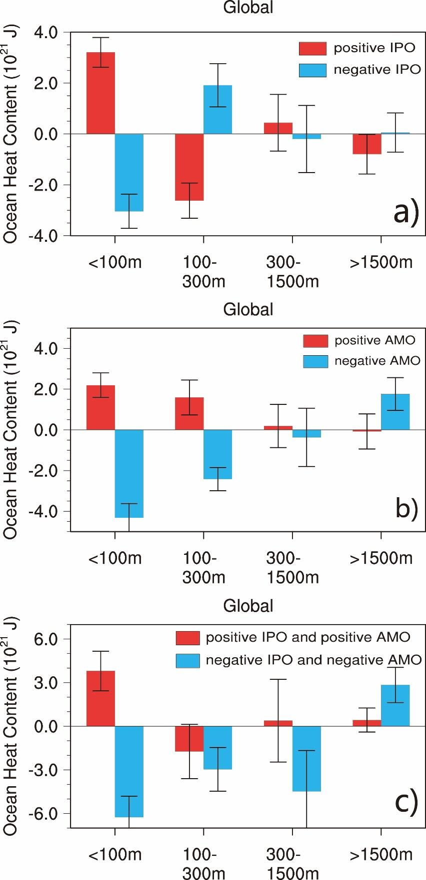
Contributions of Interdecadal Pacific Oscillation and Atlantic Multidecadal Oscillation to Global Ocean Heat Content Distribution
Objective
Regional sea surface temperature (SST) mode variabilities, especially the La Niña-like Pacific Ocean temperature pattern known as the negative phase of the Interdecadal Pacific Oscillation (IPO), and the associated heat redistribution within the ocean are the leading mechanisms explaining the recent global warming hiatus. Here we use the Community Earth System Model (CESM) version 1, to examine how different phases of two leading decadal timescale SST modes, namely the IPO and the Atlantic Multidecadal Oscillation (AMO), contribute to heat redistribution in the global ocean in the absence of time evolving external forcings.
Figure 1. Composite mean global OHC anomalies at different layers for different phases of IPO, AMO. Panel a) for IPO, red bar for positive IPO and blue bar for negative IPO; b) for AMO, red/blue bar for positive/negative AMO. Error bars denote 95% confidence interval.
Approach
Community Earth System Model version 1 (CESM1) with 1 degree resolution is our tool.
Last 1000 years of the CESM1 LE 22-hundred years 1850 preindustrial control run
Climate modes: IPO and AMO
Ocean heat content changes
Impact
Our results show that both IPO and AMO can modulate the ocean heat content distribution.
The major influence of IPO is in the Pacific basin, and the major influence of AMO is in the Atlantic with significant impact to other basins in association to AMOC.
IPO can induce an seesaw-like heat content change between surface and subsurface oceans.
AMO will in general induce heat content change with the same sign up to 1500m depth.
Hu, Z., A. Hu$, Y. Hu, 2017: Contributions of Interdecadal Pacific Oscillation and Atlantic Multidecadal Oscillation to Global Ocean Heat Content Distribution, J. Climate, DOI: 10.1175/JCLI-D-17-0204.1, accepted. $corresponding author.

