Slide 1
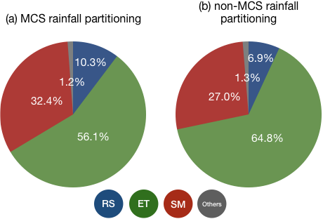
The Intensity of Rainfall Changes How It Affects Land
Objective
Examine how the varied intensities of rainfall associated with mesoscale convective systems (MCSs) and non-MCS events affect surface hydrology in the central United States.
Approach
Use a water tracer tool and unique high resolution MCS database to numerically tag rainfall sourced from MCS and non-MCS events and track rain transit in the terrestrial system in a land surface model.
Quantify MCS vs non-MCS rainfall contributions to major surface water balance components (surface runoff, evapotranspiration, and soil moisture) throughout the warm season.
Impact
Light-to-moderately intense non-MCS rainfall contributes more to evapotranspiration, while more intense MCS rainfall plays a more important role in generating surface runoff.
The intensity disparity produces shallower soil infiltration of non-MCS rainfall and deeper percolation of MCS rainfall into the soil, resulting in different soil residence times.
The clear differences in the hydrological footprints of MCS and non-MCS rainfall and their corresponding soil moisture profiles imply further differences in their impacts on subsequent soil-precipitation feedbacks and ecosystems.
Warm-season MCS and non-MCS rainfall partitioned into three key components: surface runoff (RS), evapotranspiration (ET) and soil moisture (SM) at the season’s end. A majority of warm-season rainfall leaves the surface-subsurface system through ET, although non-MCS rainfall contributes a larger fraction. In contrast, MCS rainfall produces more RS, as its higher intensity more often exceeds the infiltration capacity of the soil. Non-MCS rainfall with its light-to-moderate intensity resides mostly in the top soil layer and thus contributes more to ET through soil evaporation.
Hu, H., L. R. Leung, and Z. Feng, 2020. “Understanding the distinct impacts of MCS and non-MCS rainfall on the surface water balance in the central US using a numerical water-tagging technique”. J Hydrometeorol, 21, 1–38, https://doi.org/10.1175/jhm-d-20-0081.1.

