Slide 1
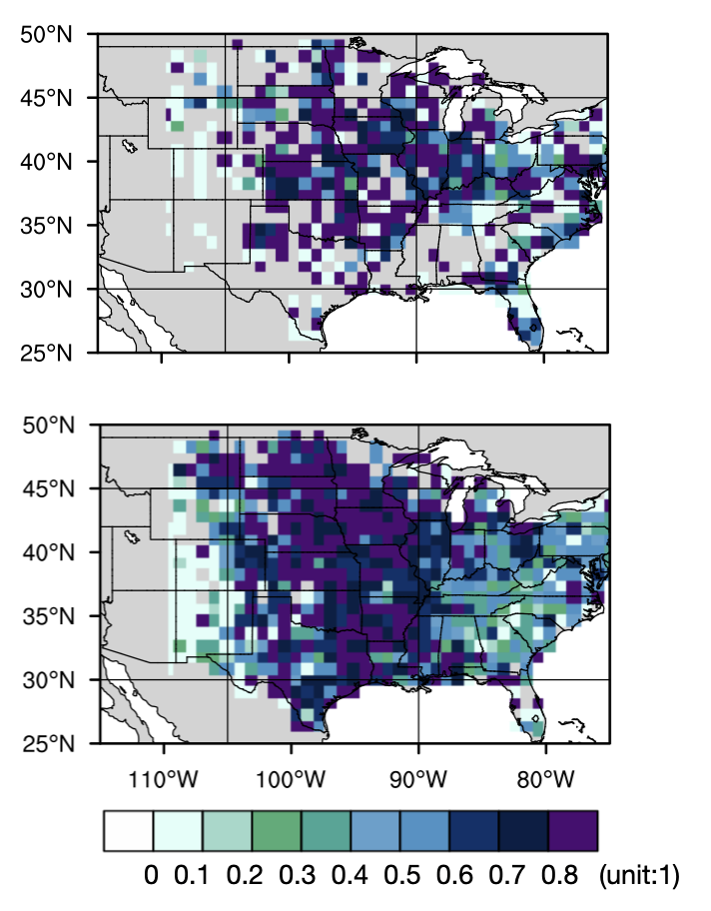
Mesoscale Convective Systems Cause Most Warm-Season Floods in the Central-Eastern U.S.
Objective
Examine the likelihood of flooding associated with mesoscale convective systems (MCSs) and identify the dominant MCS characteristics affecting flood occurrence.
Approach
Link flooding events from the Storm Event Database with high-resolution MCS data to attribute the occurrence of different flood types (slow-rising, flash, and hybrid floods) to MCS and non-MCS storms.
Investigate relationships between flood occurrence and different MCS characteristics.
Impact
MCSs account for most slow-rising and hybrid floods during the warm season in the central and eastern U.S.
Half of the flash floods in July and August are related to frequently occurring isolated convection that produces locally intense rainfall.
MCSs with larger rainfall areas produce more floods, while slower-propagating MCSs produce longer flash floods.
The critical role of MCS rainfall area on flood occurrence can improve projections of future flood risks in response to warming-induced changes to MCSs.
Spatial patterns of fractions of slow-rising floods (upper panel) and flash floods (lower panel) associated with MCSs averaged over April–August 2007–2017. About 65% of slow-rising floods are associated with MCSs east of 110$°$W. Meanwhile, MCS rainfall accounts for most flash floods occurring between 105$°$W and 90$°$W, while most flash floods near the Rocky and Appalachian Mountains are associated with non-MCS individual convective cells.
Hu, H., Z. Feng, and L. R. Leung, “Linking Flood Frequency With Mesoscale Convective Systems in the US.” Geophys. Res. Lett., 48, (2021). [DOI: 10.1029/2021gl092546]

