Slide 1
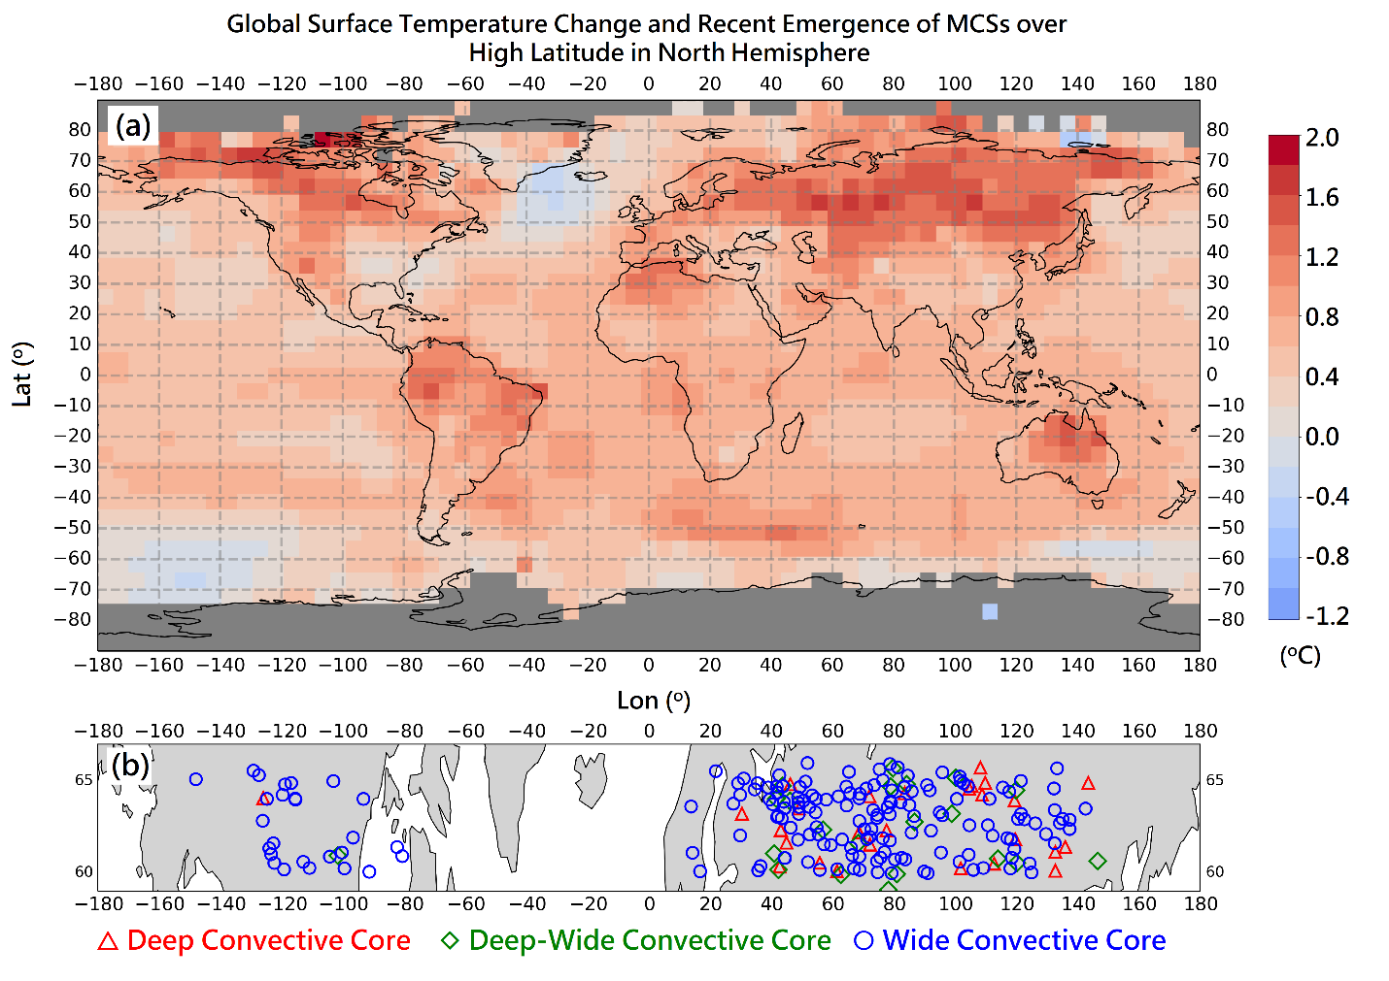
Extreme Convective Storms Occur at
High-Latitude Continents
Objective
Establish the global pattern of the occurrence of high-latitude convective storms
Approach
Analyze the Global Precipitation Measurement (GPM) core satellite data and concurrent global reanalysis data
Examine the correlation between the occurrence of those strong storms and surface warming, and associated wind, stability, and humidity
Impact
Deep convective storms often occur during the warm season (April‒September) in the high-latitude continents where the surface temperature increase has been greatest
Colocation of extreme convective storms and the largest surface warming of the globe suggests that these storms could become more common in a continually warming world
The GPM-detected high-latitude extreme convective storms (b) occurred in the areas with the largest surface warming (a).
Houze RA, Jr., J Wang, J Fan, S Brodzik, and Z Feng. 2019. “Extreme Convective Storms Over High-Latitude Continental Areas Where Maximum Warming Is Occurring.” Geophysical Research Letters 46(7):4059‒4065, https://doi.org/10.1029/2019GL082414.
Notes:
http://www.pnnl.gov/science/highlights/highlights.asp?division=749

