Slide 1
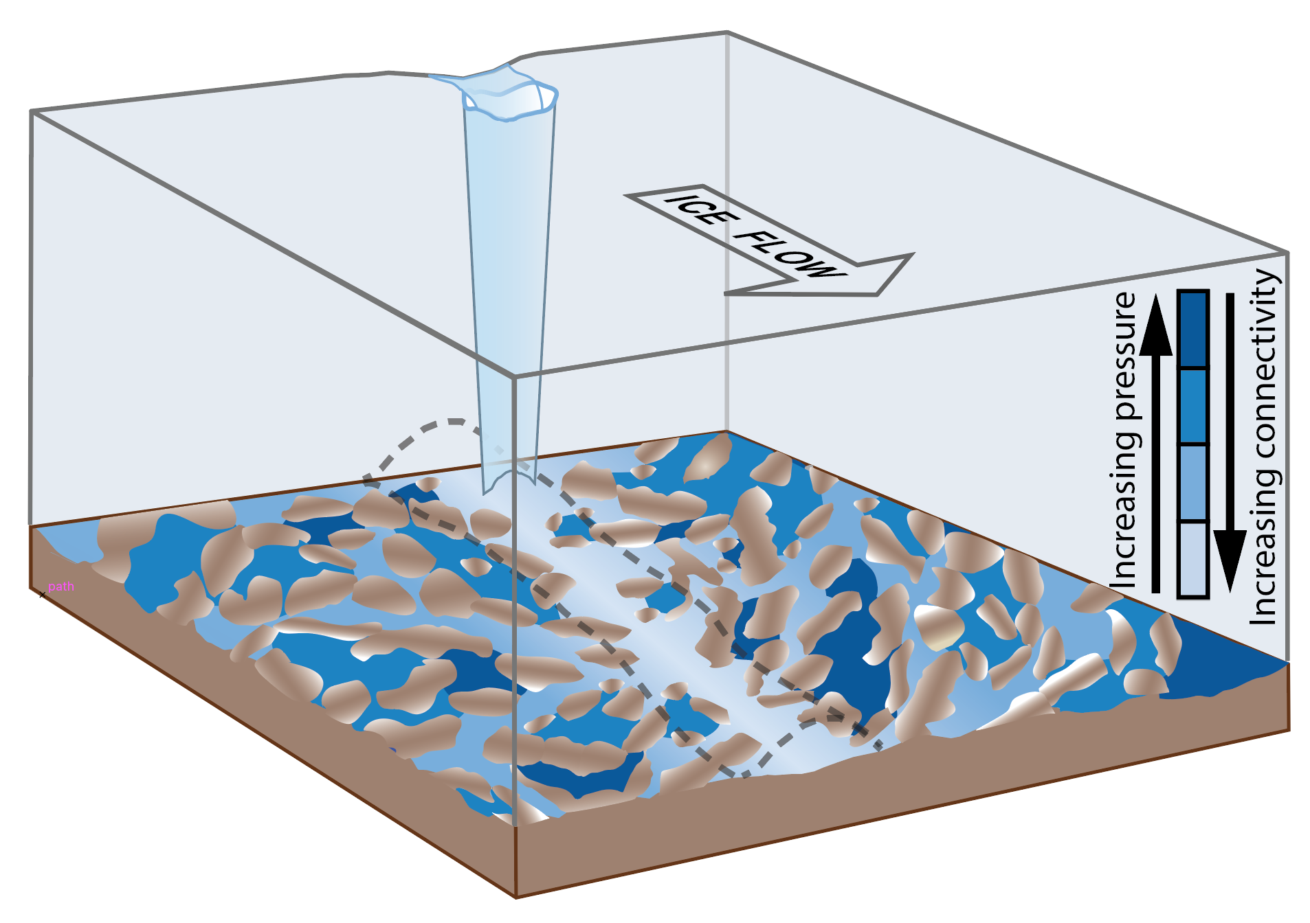
Greenland subglacial drainage evolution regulated by weakly connected regions of the bed
Objective
Surface meltwater draining to the bed of the Greenland Ice Sheet each summer causes ice flow changes that cannot be fully explained by the prevailing theory of channelizing subglacial drainage. Can changes in weakly connected, swampy areas of the bed that have been previously ignored explain why the ice sheet slows down in late summer and winter?
Research
Develop model for weakly-connected drainage and couple to standard subglacial drainage model that includes distributed and channelized flow.
Simulate a well-studied field site in Greenland by forcing the enhanced model with measurements of meltwater input to subglacial drainage system.
Compare versions of the model with and without weakly-connected drainage to measurements of water pressure in different parts of the drainage system and with ice sheet surface velocity.
The weakly connected drainage component is necessary to reproduce the observations.
Swampy backwaters of the subglacial drainage system slowly drain water toward efficient channels, lowering system-wide water pressure and slowing the ice sheet.
Impact
The existing conceptual model for subglacial drainage needs to be expanded to include the new component of weakly-connected drainage. Slow draining of swampy subglacial backwaters regulates the ice flow response to summer lubrication of the bed. These areas may control how the ice sheet responds to future changes in melt.
Reference: Hoffman, M. J., L. C. Andrews, S. A. Price, G. A. Catania, T. A. Neumann, M. P. Luethi, J. Gulley, C. Ryser, R. L. Hawley, and B. F. Morriss (2016), Greenland subglacial drainage evolution regulated by weakly-connected regions of the bed, Nat. Commun., In Press.

