Slide 1
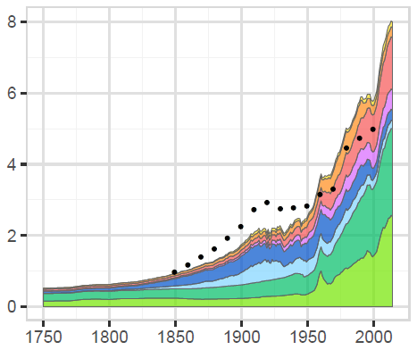
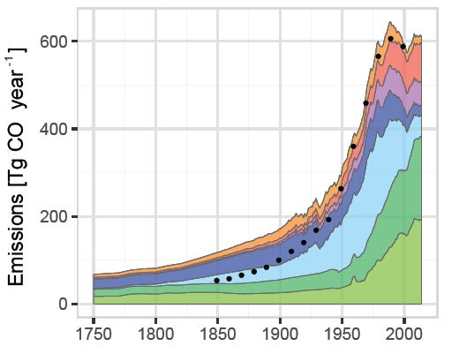
New Historical Emissions Data for CMIP6 and Beyond
Historical emissions produced by the Community Emissions Data System (stacked area graph by region) compared with global CMIP5 (Coupled Model Intercomparison Project Phase 5) emissions (black dots). For like-with-like comparison, this figure does not include aviation or agricultural waste burning.
Objectives
Create an open-source system to produce transparent, reproducible, gridded emissions trends for CO, OC, BC, SO₂,NO_{X}, NH₃, NMVOC, CH₄, and CO₂ from 1750–present; estimates are at country, sector, and fuel resolution with monthly seasonality and NMVOC speciation
Release software data system in winter 2018 as open source, followed by an update to extend the time series to 2016
Approach
Use existing Community Emissions Data System energy data sets (IEA Energy statistics) and regional and country-specific inventories to estimate trends over time
Calibrate results to country-level inventories where these are available
Extend data using consistent driver data to form a complete time series
Impact
New reproducible methodology will help produce more consistent emissions trends over time
Open-source release will facilitate feedback from the global emissions community
In next steps, explore uncertainty in emission estimates and create emissions ensembles rather than point estimates
Hoesly RM, SJ Smith, L Feng, Z Klimont, G Janssens-Maenhout, T Pitkanen, JJ Seibert, L Vu, RJ Andres, RM Bolt, TC Bond, L Dawidowski, N Kholod, J Kurokawa, M Li, L Liu, Z Lu, MCP Moura, PR O’Rourke, and Q Zhang. 2018. “Historical (1750–2014) Anthropogenic Emissions of Reactive Gases and Aerosols from the Community Emissions Data System (CEDS).” Geoscientific Model Development 11:369-408. DOI: 10.5194/gmd-11-369-2018

