Slide 1
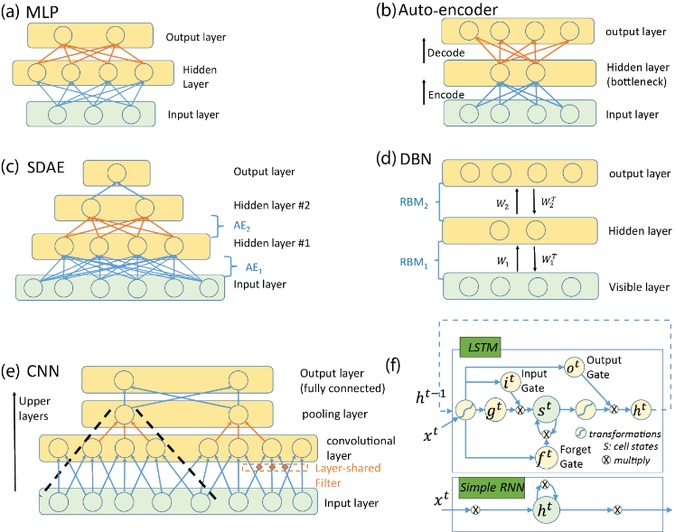
A trans‐disciplinary review of deep learning research and its relevance for water resources scientists
g
Objective
Introduction and review the progress of deep learning (DL) for water resources applications.
Technical review of DL.
Trans-disciplinary update on the use of DL for scientific advancement.
Identify potential applications of utilizing DL to advance water sciences.
Figure. (a-f) network structures reviewed in the paper. (a) vanilla multi-layer perceptron network; (b) auto-encoder; (c) stochastic denoising auto-encoder; (d) deep belief network; (e) convolutional neural network; (f) long short-term memory; (g) relevance back-propagation to understand pixels in the input image that led the network to make its decision
Findings
DL can help address several major new and old challenges facing research in water sciences such as inter‐disciplinarity, data discoverability, hydrologic scaling, equifinality, and needs for parameter regionalization.
Various physical and geoscientific disciplines have utilized DL to address data challenges, improve efficiency, and gain scientific insights.
A new area termed “AI neuroscience,” where scientists interpret the decision process of deep networks and derive insights, has demonstrated methods including correlation‐based analysis, inversion of network‐extracted features, reduced‐order approximations by interpretable models, and attribution of network decisions to inputs.
Vast opportunities exist for DL to propel advances in water sciences.
Shen, C. (2018), A trans-disciplinary review of deep learning research and its relevance for water resources scientists, Water Resour. Res., doi:10.1029/2018WR022643. (DE-SC0016605)

