Slide 1
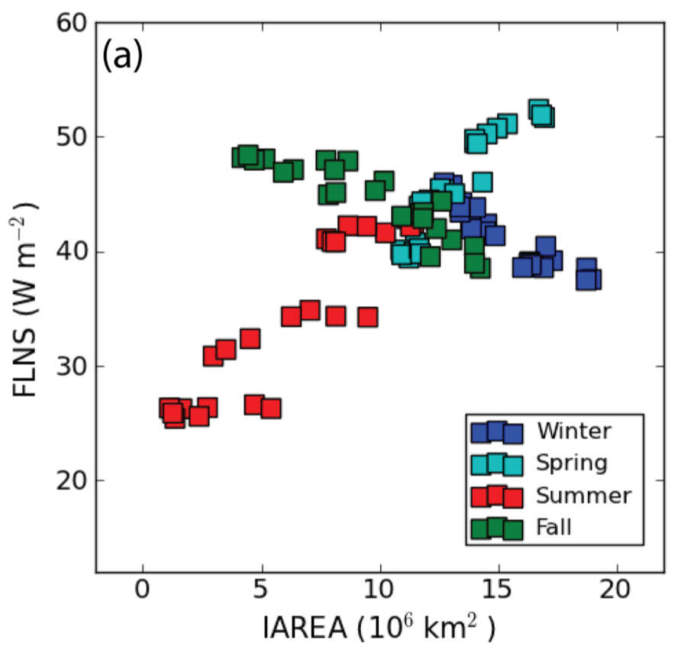
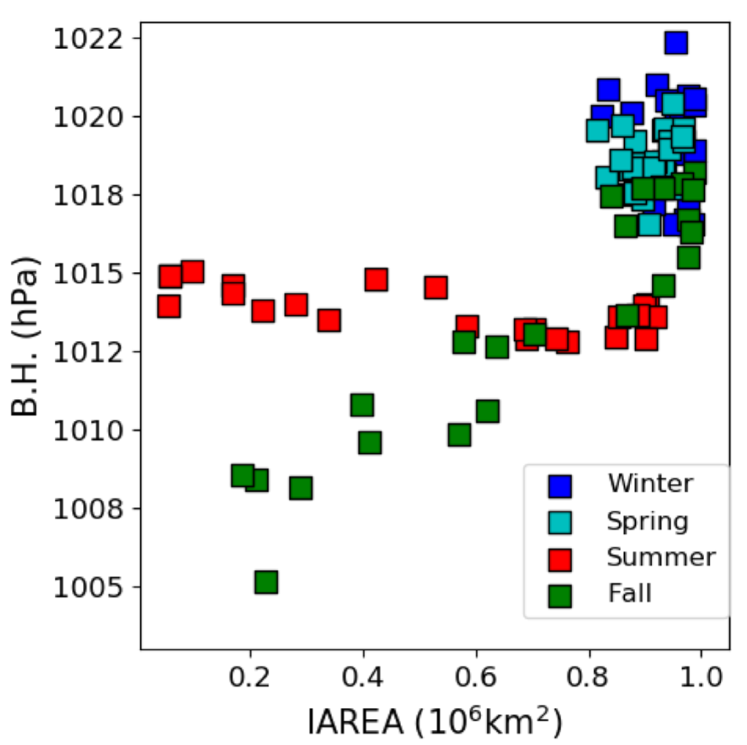
Emergent relationships among sea ice, longwave radiation, and the Beaufort High
Objective: To determine statistical constraints (emergent relationships) among Arctic climate variables in the context of coupled climate simulations, which can enhance understanding of future climate at high latitudes, including poorly understood interactions and feedbacks among Arctic clouds, sea ice, and ocean.
(b)
Approach:
Produce a perturbed parameter ensemble of the E3SMv0-HiLAT coupled climate model based on uncertainties in cloud, sea ice, and ocean model parameters. The ensemble output encompasses a broad range of climate states.
Examine statistical relationships across the ensemble to identify emerging relationships among pairs of climate variables.
Consideration of physical mechanisms lends credibility to emergent constraints among 1) longwave radiation balance and sea ice, and 2) sea level atmospheric pressure over the Beaufort Sea and the Arctic sea ice coverage.
Figure: Scatterplots of simulated (a) seasonal‐mean net longwave radiation at the ice‐ocean surface (FLNS) and (b) seasonal‐mean sea level pressure (B.H.) versus the sea ice area (IAREA) over the Beaufort Sea show seasonal relationships across the 24-member ensemble.
Impact: Using a novel approach, we identify two emergent relationships in the response of the Arctic climate simulated by E3SMv0-HiLAT across different climate states. These two constraints can guide further research to refine our understanding of high latitude feedbacks. Moreover, this research demonstrates a more efficient space-filling sampling methodology for examining sensitivities to model parameters in fully coupled climate simulations, useful for model calibration.
Urrego-Blanco, J., Hunke, E.C., and Urban, N., “Emergent relationships among sea ice, longwave radiation, and the Beaufort high circulation exposed through parameter uncertainty analysis”, JGR-Oceans (2019), doi.org/10.1029/2019JC014979 .
Notes:
Wanda says that this is a general slide with no specific reference

