Slide 1
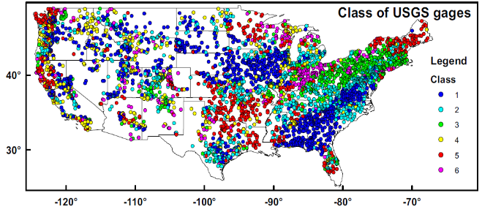

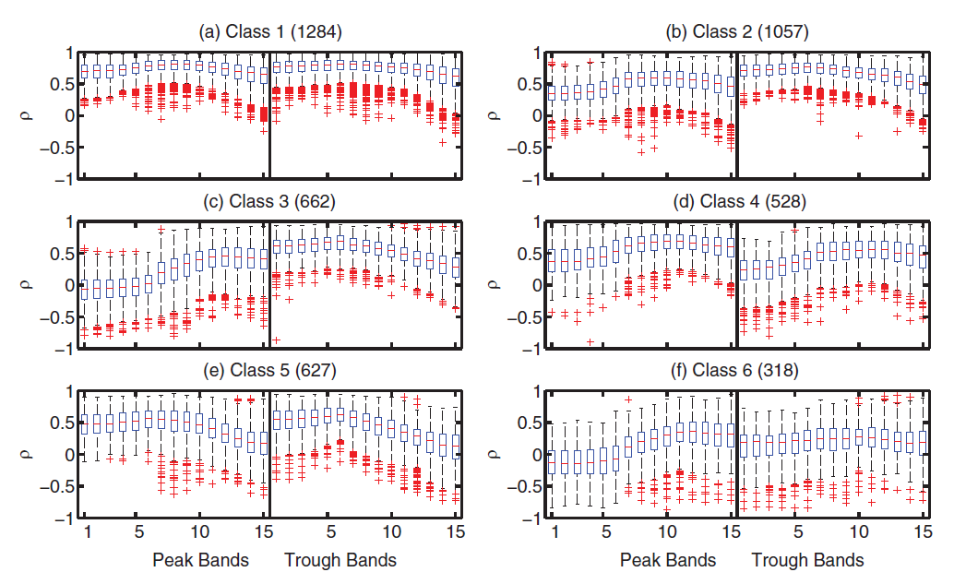
Revealing causal controls of storage-streamflow relationships with a data-centric Bayesian framework combining machine learning and process-based modeling
(a)
(b)
(c)
Objective
What physical factors cause the storage-streamflow relationships to differ between Appalachia and the coastal plains?
Approach
A machine learning (ML) was implemented to identify potential competing hypotheses for storage-streamflow relationships (providing the prior probability).
A process-based hydrologic model (CLM-PAWS) was set up to conduct causal experiments of storage-streamflow relationships (computing likelihoods for factors)
A data-centric Bayesian framework to integrate data and the results from the modeling experiments.
Class 1
Class 2
Class 3
Peak bands
Trough bands
(d)
(e)
Subbasin : OR
Figures (a) Class map of eastern CONUS; (b) boxplots of the SSCS for Class #1 to Class #3; (c) Main class of Susquehanna River Basin (SRB) SSCS is class #3; (d) SSCS extracted from the numerical experiments in subbasin OR. “Thin soil” is the default simulation with SRB-default parameters; (e) the likelihood function as calculated by Gaussian Mixture Model (GMM) in different PAWS+CLM experiments.
Conclusions
Although ML suggested that soil thickness and soil texture can both be causal factors, the PBM experiments unequivocally affirmed soil thickness as the one.
This example promotes an alternative ML-PBM integration methodology to integrating machine learning and process-based models.
A Bayesian framework can be autonomously executed by a program and could be regarded as giving process-based models to machine learning as diagnosis tools.
Tsai, W-P., K. Fang, X.Y. Ji, K. Lawson, and C.P. Shen (2020) "Revealing causal controls of storage-streamflow relationships with a data-centric Bayesian framework combining machine learning and process-based modeling" Front. Water, doi: 10.3389/frwa.2020.583000.

