Slide 1
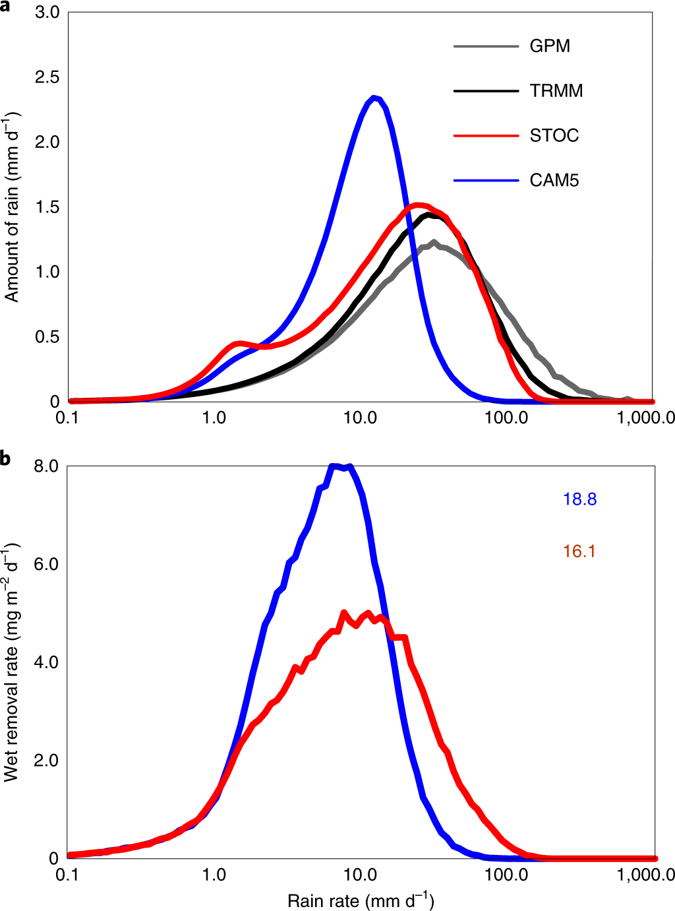
Disproportionate control on aerosol burden by light rain
Objective
Improve the atmospheric aerosol burden simulation in climate models via better representation of convection.
Approach
Couple the stochastic deep convection scheme with the Zang-McFarlan (ZM) deterministic deep convection scheme.
Link the aerosol wet removal with the improved rainfall rate.
Conclusion
The light rain (1-20 mm/d) occurs much less frequently and better matches observations in EAMv1 and CAM5, reducing the well-known bias of ‘too much light rain and too little heavy rain’.
Aerosol burden increases globally, especially over the tropics and subtropics.
It is attributed to the reduction in the highly-efficient aerosol wet removal by light rain.
Figure: Rainfall & wet removal amount. a,b, Amount distributions of total daily rainfall (a) and wet removal of all aerosols (b) by different rainfall intensities over the tropics (20° S–20° N).
Wang, Y., Xia, W., Liu, X., Xie, S., Lin, W., Tang, Q., Ma, H.-Y., Jiang, Y., Wang, B. & Zhang, G.J., Disproportionate control on aerosol burden by light rain. Nature Geoscience (2021). doi:10.1038/s41561-020-00675-z

