Slide 1
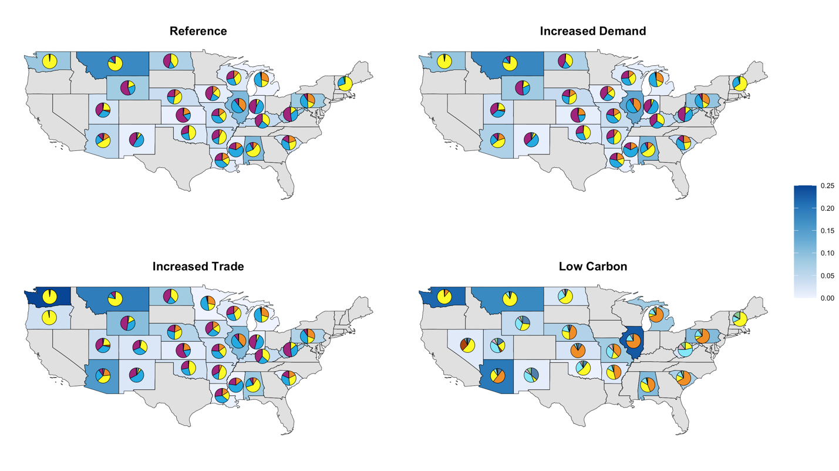
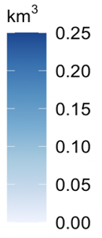
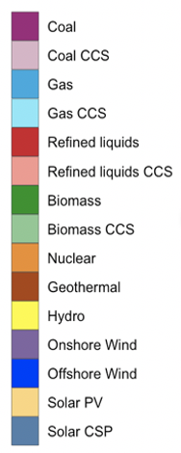
Tracking Future Virtual Water in the United States Electricity Sector
Objective
Understand the degree of water reliance and dependency of electricity traded between different states and grid regions.
Approach
Quantify the total water required to generate the electricity traded between states or grid regions.
Evaluate the impact of different degrees of electricity trade accessibility and demand across 15 electricity grid regions in the United States.
Investigate changes brought upon by low carbon futures.
Impact
Discovered that despite a nearly 20% increase in U.S. electricity generation by 2050, virtual water exports from states will decline by 3%. Socioeconomic, transmission, and technology transitions can result in virtual water export increases of up to 32%.
Presents the first analysis of future virtual water trading in the electricity sector, which lays the foundation for future regional and global studies.
Independent of energy future, coal retirement dampens virtual water trade growth; mid-century virtual water trading in the U.S. electricity sector will depend on a few major exporting states. The states in blue highlight volumetric virtual water exports.
Graham N T, G Iyer, M Wise, M Hejazi, and T Wild. “Future evolution of virtual water trading in the United States electricity sector.” Environmental Research Letters, 16, 124010 (2021), [DOI: 10.1088/1748-9326/ac3289].
Notes:
http://www.pnnl.gov/science/highlights/highlights.asp?division=749

