Slide 1
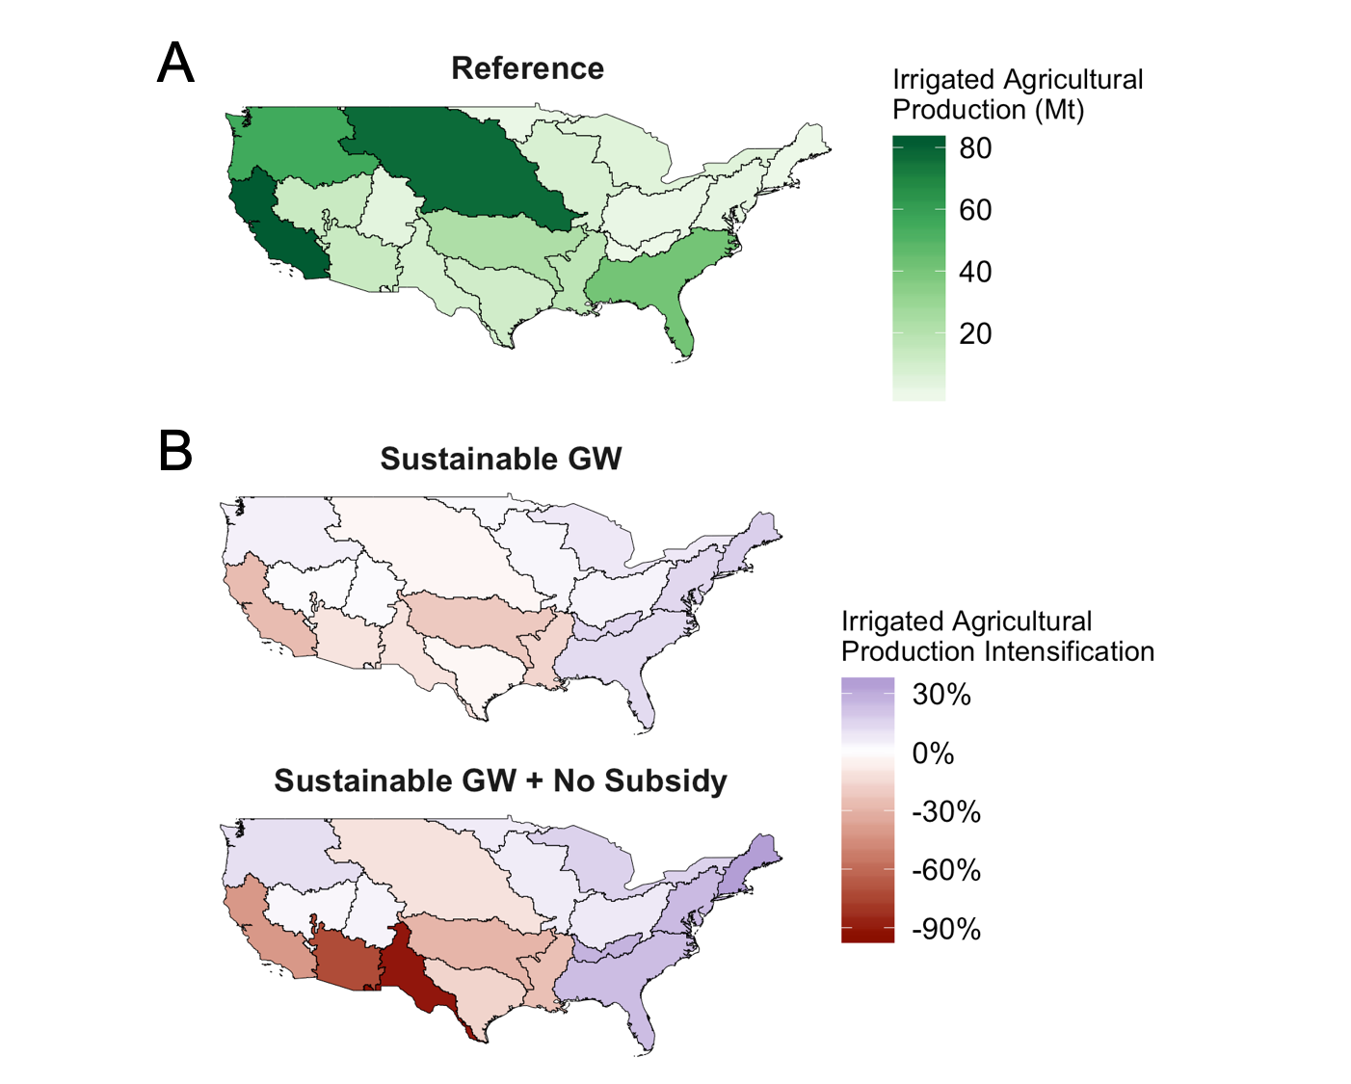
Impacts of Limiting Unsustainable Water Use in the United States
Objective
Understand the implications of increasing future sustainable water use in the United States.
Approach
Investigate the effects of limiting nonrenewable groundwater extraction and eliminating water pricing subsidies.
Quantify the agricultural impacts of increasingly stringent sustainable water use scenarios, specifically at basin-level production and revenue.
Impact
Provided the first analysis of the impacts of limiting nonrenewable groundwater resources in the United States.
Found that water constraints in the Southwest drive increases in irrigated agricultural production in the East.
Increased sustainability measures will reduce overall agricultural exports from the United States by up to 5% by the end of the century.
Agricultural production in the United States will shift from the Central and Southwest regions to the Pacific Northwest and the East Coast by the end of the century in response to nonrenewable groundwater use constraints and water sector pricing changes.
Graham N T, G Iyer, M I Hejazi, S H Kim, P Patel, and M Binsted. 2021. “Agricultural impacts of sustainable water use in the United States.” Scientific reports, 11(1): 1–9. [DOI: 10.1038/s41598-021-96243-5]
Notes:
http://www.pnnl.gov/science/highlights/highlights.asp?division=749

