Slide 1
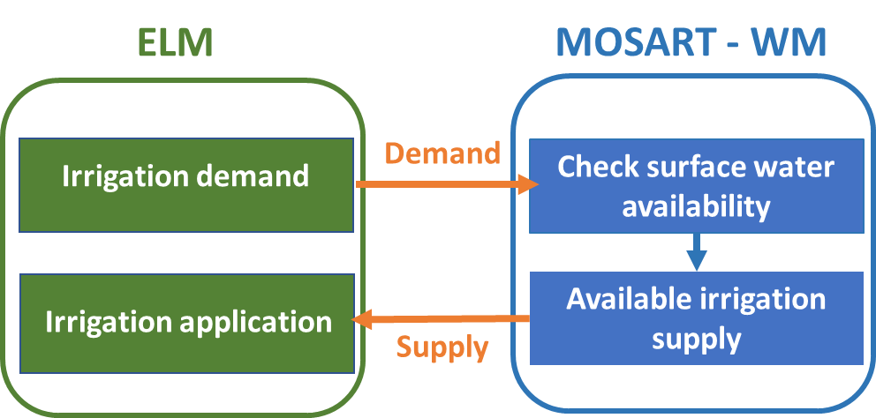
River and Reservoir Water Availability Guides Global Irrigation Modeling
Objective
Improve irrigation modeling in the Energy Exascale Earth System Model (E3SM) by implementing a two-way coupled irrigation scheme that constrains surface water irrigation via available runoff, streamflow, and reservoir storage.
Approach
Implement the new two-way coupled irrigation scheme into E3SM and use numerical experiments to test model response in various scenarios.
Evaluate water budget distributions across the experiments to quantify the impacts of different irrigation representations on the overall Earth system.
Impact
The two-way irrigation scheme better represents global groundwater recharge and level decline and can capture the seasonal dynamics of irrigation water allocation that reflect local water conditions.
The more accurate representations of global water dynamics in E3SM will allow researchers to further interrogate the effects of irrigation water use.
The newly developed two-way coupled irrigation scheme allows the E3SM Land Model (ELM) and E3SM river and water management models (MOSART-WM) to exchange information for a more dynamic and accurate representation of irrigation. This provides better overall representations of irrigation and its impacts on the water cycle.
Zhou, T., Leung, L. R., Leng, G., Voisin, N., et al. 2020. “Global irrigation characteristics and effects simulated by fully coupled land surface, river, and water management models in E3SM,” Journal of Advances in Modeling Earth Systems, 12. DOI: 10.1029/2020MS002069

