Slide 1
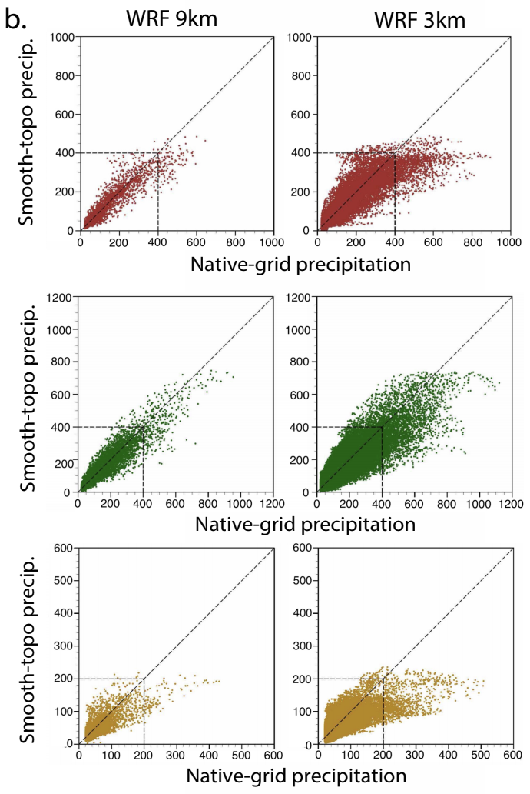
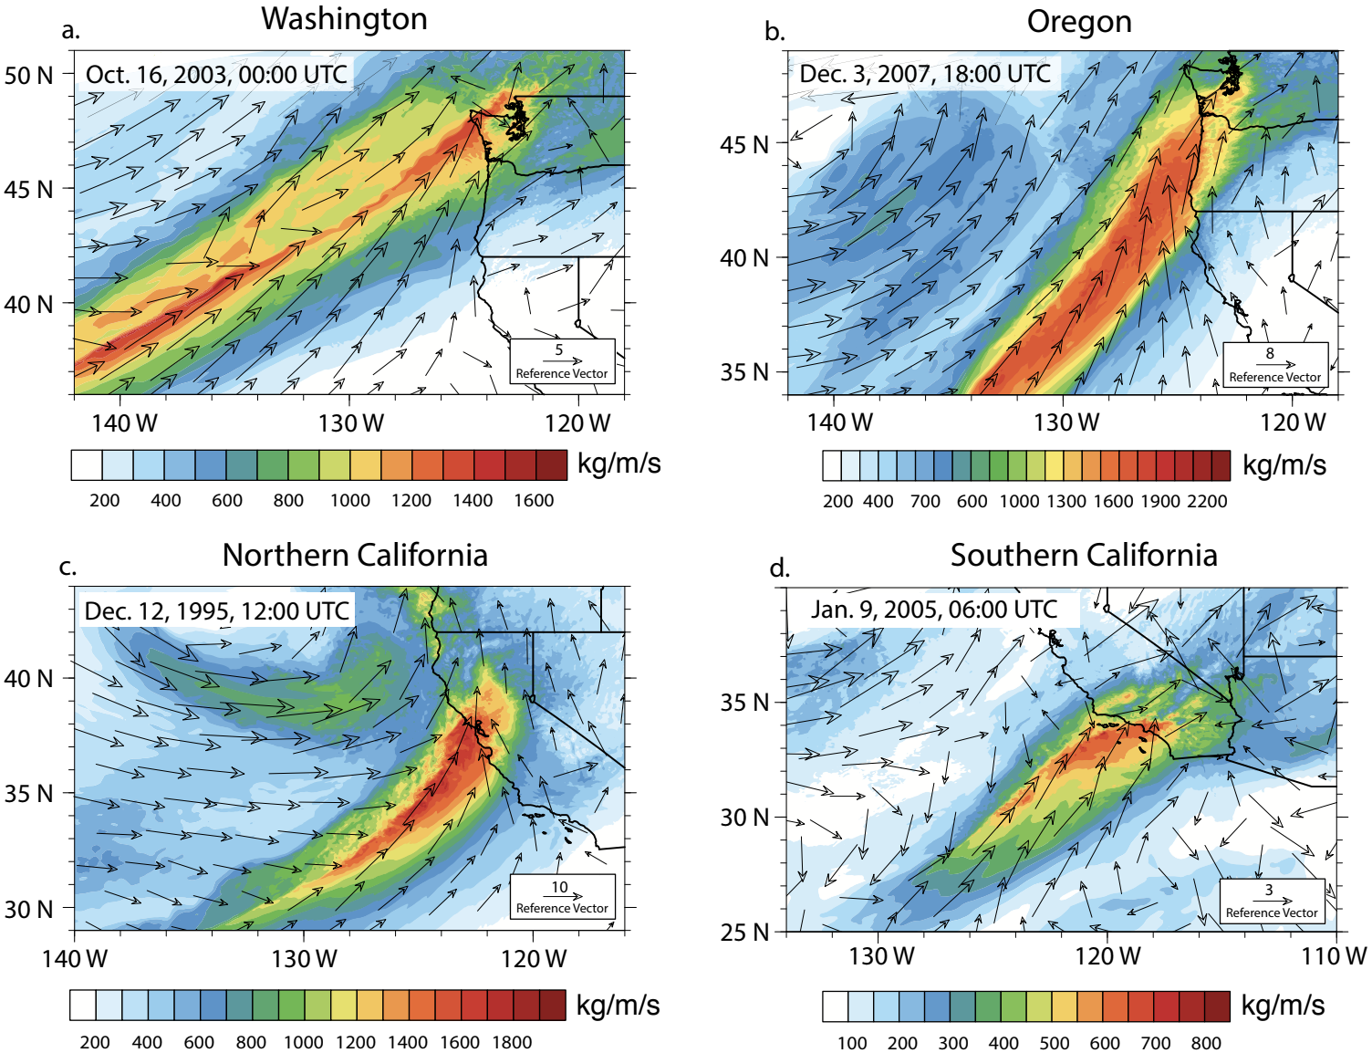
Simulating and Evaluating Atmospheric River Induced Precipitation Extremes along the US Pacific Coast: Case Studies from 1980‐2017
In this study, we investigate the enhanced value of high-resolution downscaling as it pertains specifically to AR-related precipitation extremes, using a highly targeted, individual storm-based case study approach that leverages a multiscale modeling framework. Our efforts target the most extreme historical AR events across the U.S. West Coast between 1980 and 2017 most of which were storms that had notable societal impacts.
High-resolution modeling captures key characteristics of extreme atmospheric rivers and well reproduces heavy precipitation and associated meteorological features. Targeted simulations can advance the studying of climatic extreme changes to a warming climate, with the potential to provide watershed-specific projections of heavy precipitation events contributing to considerable relevance—from short-term forecast-informed reservoir operations to long-term climate adaptation activities.
Simulated integrated vapor transport (IVT) (kg/m/s) from selected extreme AR events in each region.
A targeted selection of the most intense historical AR events making landfall on the U.S. west coast are selected using an object-oriented AR detection approach.
Dynamically downscaled these events, using nested WRF simulations to examine extreme precipitation and other relevant fine-scale thermodynamic and kinematic quantities event by event.
Insights into the importance of fine spatial resolution in the representation of precipitation and water vapor transport extrema—as well as resolution-dependent drivers in topographically complex regions; Differing effects of model horizontal resolution and improved resolution of complex topography.
Shared Data: http://portal.nersc.gov/ project/m2637/ARs
Huang, X., Swain, D.L., Walton, D.B., Stevenson, S. and Hall, A.D. (2020), Simulating and Evaluating Atmospheric River Induced Precipitation Extremes along the US Pacific Coast: Case Studies from 1980‐2017. Journal of Geophysical Research: Atmospheres, p.e2019JD031554.

