Slide 1
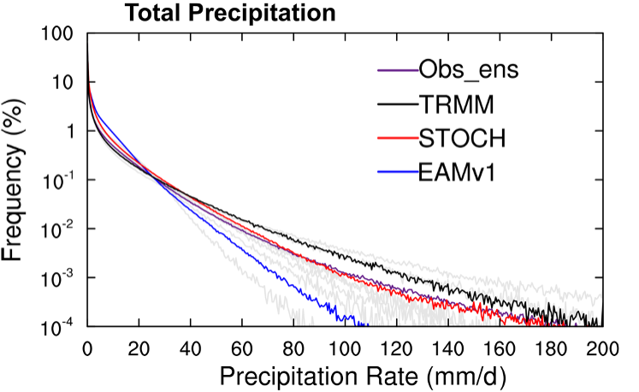
Effects of coupling a stochastic convective parameterization with the Zhang–McFarlane scheme on precipitation simulation
Objective
Improve the precipitation simulation in DOE E3SM EAMv1 via better representation of convection.
Approach
Couple a stochastic deep convection scheme with the Zang-McFarlan (ZM) deterministic deep convection scheme.
Conclusion
The well- known problem of “too much light rain and too little heavy rain” is alleviated, especially over the tropics (see Figure).
The mean precipitation amount distribution is improved with more precipitation contribution from more intense precipitation events.
The synoptic and intraseasonal variabilities of precipitation are enhanced and are closer to observations.
The “too much light rain and too little heavy rain” problem is alleviated with the use of a stochastic deep convection scheme.
Total Precipitation PDF
Figure: Frequency distributions of total precipitation intensity over the tropics (20° S–20° N). (Gray lines: Observation ensembles, with their mean represented by the purple line)
Wang, Y., G. J. Zhang, S. Xie, W. Lin, G. C. Craig, Q. Tang, and H.-Y. Ma, (2021) Effects of coupling a stochastic convective parameterization with the Zhang–McFarlane scheme on precipitation simulation in the DOE E3SMv1.0 atmosphere model. Geosci. Model Dev., 14, 1575–1593. https://doi.org/10.5194/gmd-14-1575-2021

