Slide 1
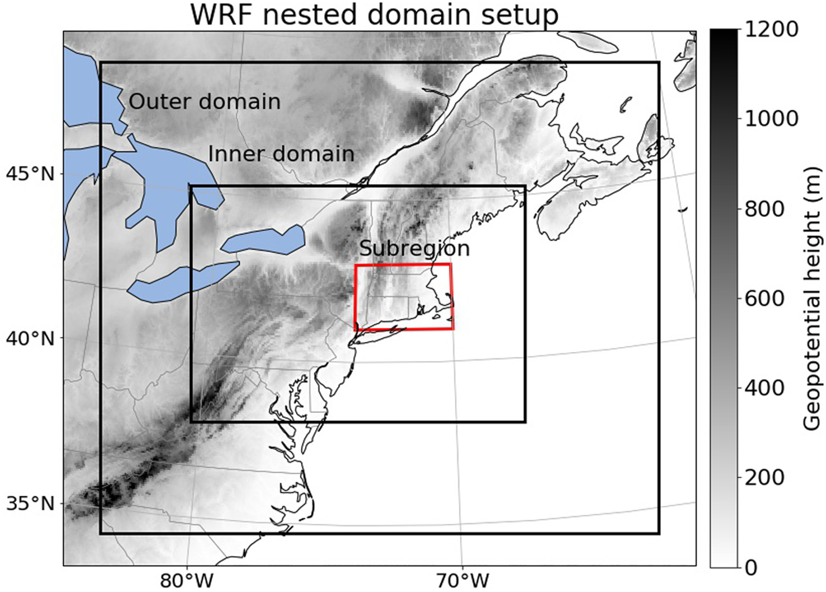
A Retrospective and Prospective Examination of the 1960s U.S. Northeast Drought
Objective
To project the hydrometeorological conditions and potential risks of a returned 1960s U.S. Northeast drought under a warming climate.
Approach
Pseudo-global warming simulations are conducted by Weather Research and Forecasting Model, and driven by the reanalysis data with the same dynamical conditions of the historical weather events, but with modified thermodynamic conditions under the emission scenarios used.
Impact
Our historical simulation is shown to capture historical conditions well compared with observational and reanalysis datasets.
Potential risks of returned 1960s drought are identified, such as significant snowpack loss and surface runoff decrease during the growing season.
This study provides atmospheric forcing data which can be used in further hydrology or soil research.
Our WRF domain setup for all simulations in this study. Shading indicates the surface height. Grid spacing in the outer (inner) domain is 18 km (6 km).
Xue, Z., & Ullrich, P. (2021). A Retrospective and Prospective Examination of the 1960s U.S. Northeast Drought. Earth’s Future. [DOI: https://doi.org/10.1029/2020EF001930]
Notes:
http://www.pnnl.gov/science/highlights/highlights.asp?division=749

