Slide 1
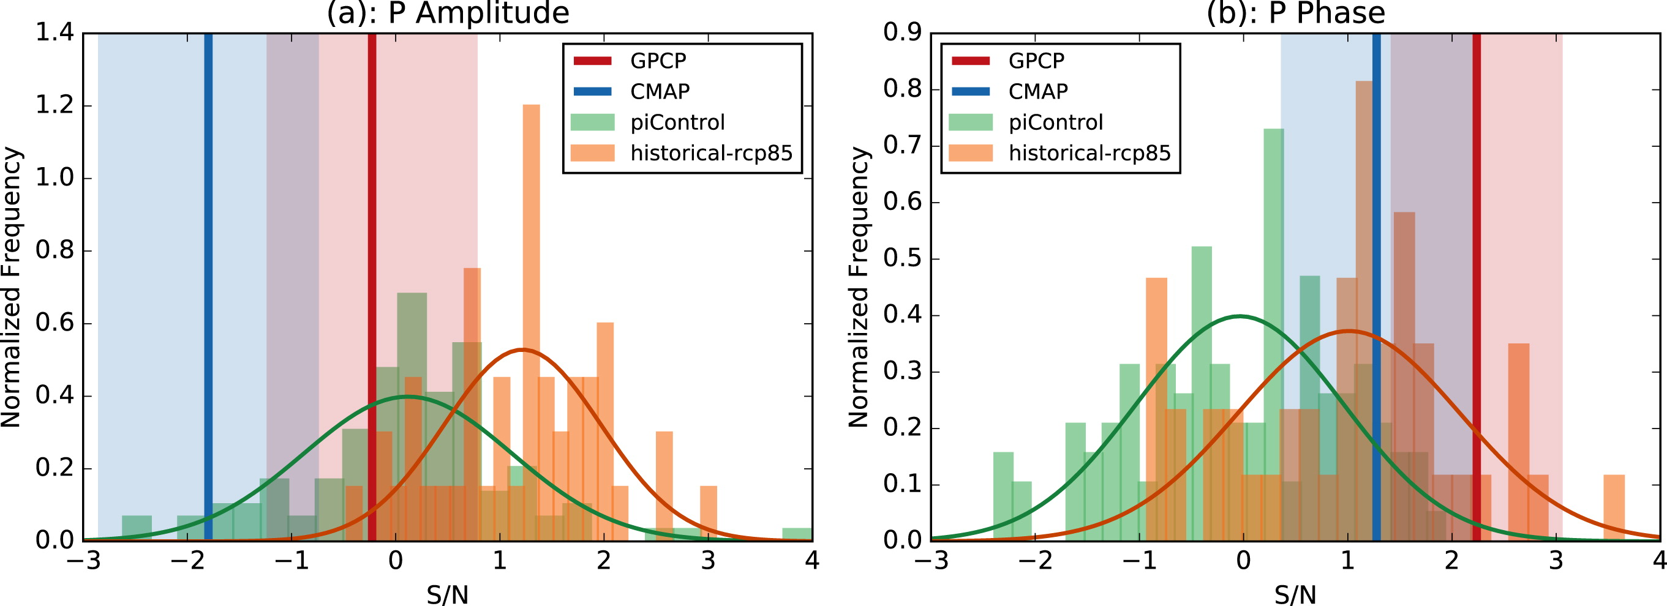
Observed and Projected Changes to the Precipitation Annual Cycle
Objective
Anthropogenic climate change is predicted to cause spatial and temporal shifts in precipitation patterns. Is it also apparent in changes to the annual cycle of zonal mean precipitation P?
Approach
Employ CMIP5 preindustrial runs to estimate unforced internal climate variability and historical simulations with estimated changes in anthropogenic and natural forcings over the period 1860–2100.
Use two observational datasets of P : Global Precipitation Climatology Project (GPCP) and the Climate Prediction Center Merged Analysis of Precipitation (CMAP) from 1979 to 2014.
Compute zonal average P(ϕ, t) of combined land and ocean precipitation, where ϕ is latitude and t is the monthly time step.
Calculate the amplitude and phase of of the best-fit sine wave with period 12 months to determine the annual cycle at each latitude.
Model fingerprints of externally forced changes to the amplitude and phase of the P seasonal cycle, combined with observations, enable a formal detection and attribution analysis.
Signal distributions for the P annual cycle (a) amplitude and (b) phase. All signals have been normalized by the standard deviation of the preindustrial control distribution (green). The orange histograms show the CMIP5 ALL+8.5 forced distributions. The observed signals are shown as vertical lines, and the shading shows the 90% confidence interval on the signals determined from the uncertainty in the regression slope.
Impact
Observed amplitude changes are inconsistent with model estimates of internal variability but not attributable to the model-predicted response to external forcing.
However, the observed changes to the annual cycle phase are inconsistent (GPCP) with estimates of internal variability, and are consistent with model estimates of forced changes. This suggests the emergence of an externally forced signal.
Marvel, Kate, Michela Biasutti, Celine Bonfils, Karl E Taylor, Yochanan Kushnir, and Benjamin Cook. 2017 Observed and Projected Changes to the Precipitation Annual Cycle. Journal of Climate, 30(13), 4983–4995. doi:10.1175/JCLI-D-16-0572.1

