Slide 1
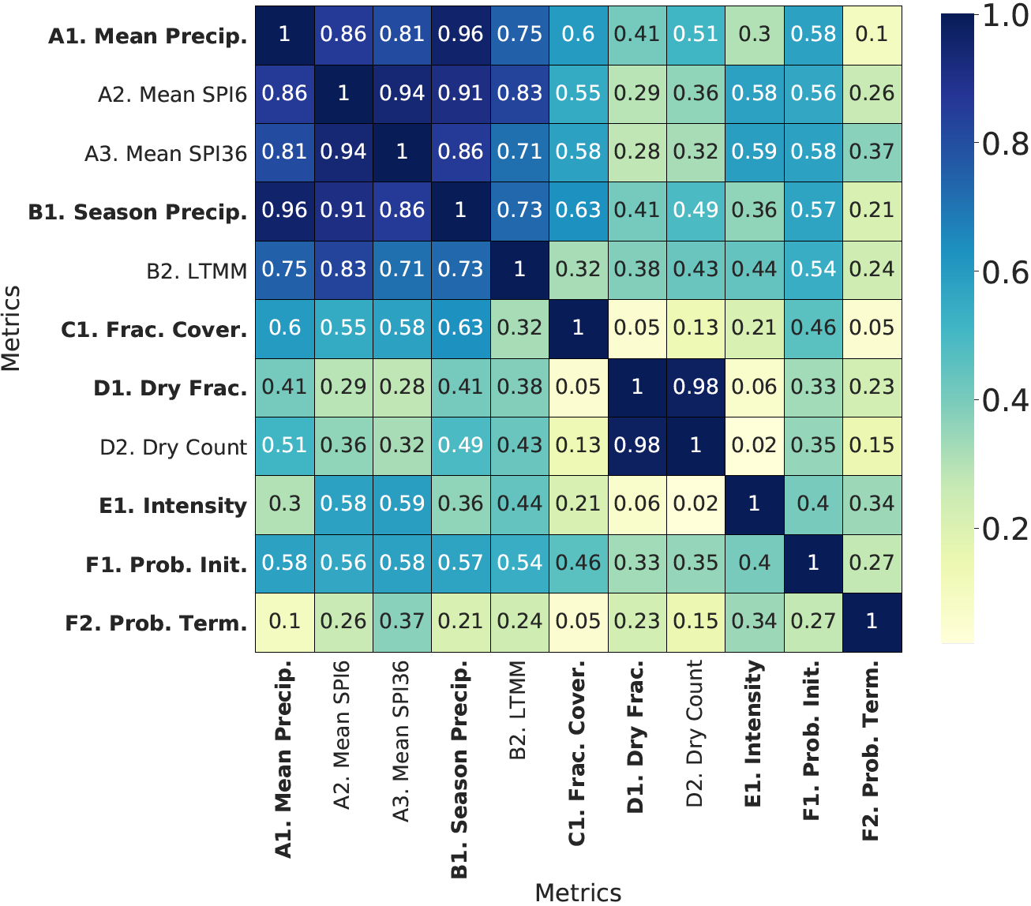
Comprehensive Intermediate-Term Drought Evaluation of Climate Datasets over the Conterminous US
Objective
A comprehensive drought-feature-based evaluation system is developed and applied to multiple datasets.
Insights are obtained into model biases over different climate products and regions.
Approach
Statistical hypothesis testing is employed for normalization of individual metrics against the threshold for statistical significance, so as to obtain an absolute assessment of model performance.
Principal feature analysis is used to select the most descriptive metrics among eleven metrics that capture the essential features of drought.
Impact
By using statistical hypothesis testing, this system can distinguish whether a group of models are all poor or all indistinguishable from observations.
The system provides a method to analyze the performance of statistical downscaling products (like LOCA) while a traditional method like a Taylor score shows essentially identical performance.
Such a feature-based evaluation system can also be developed for other weather events.
Metrics are highly correlated within each category over the California Region, but after principal feature selection, principal metrics (bold ones) are largely independent and thus can represent the most essential drought features.
Xue, Z., & Ullrich, P. (2021). A Comprehensive Intermediate-Term Drought Evaluation System and Evaluation of Climate Data Products over the Conterminous United States. Journal of Hydrometeorology. [DOI: https://doi.org/10.1175/JHM-D-20-0314.1]
Notes:
http://www.pnnl.gov/science/highlights/highlights.asp?division=749

