Slide 1
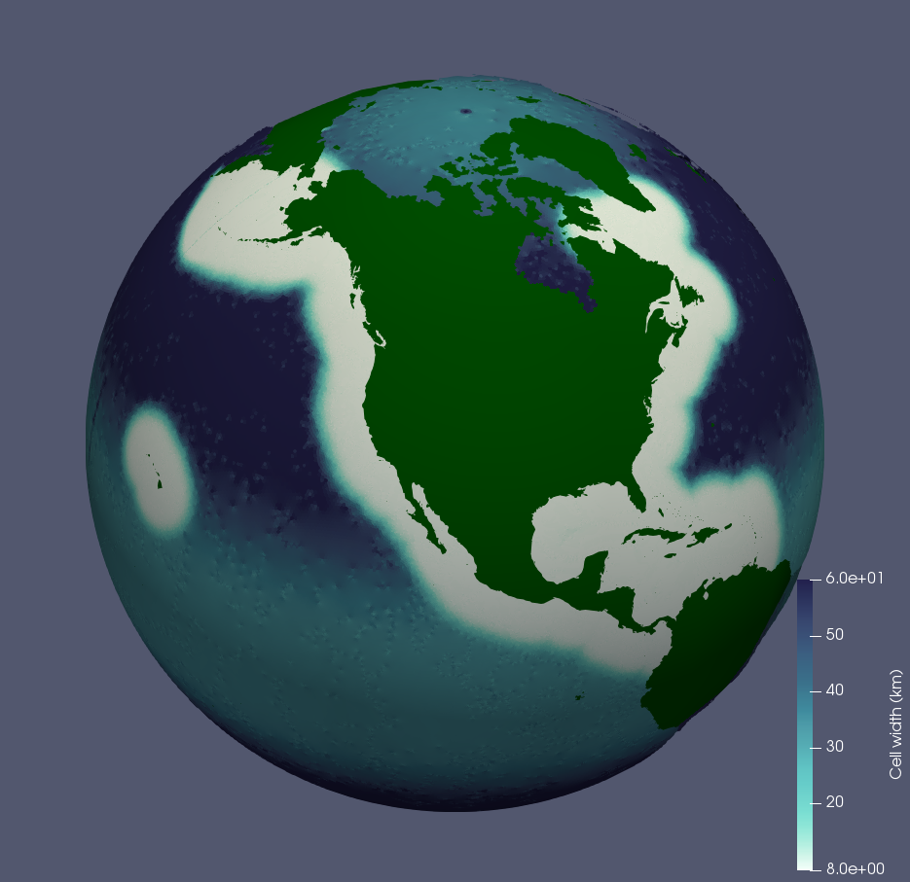
Variable-Resolution Mesh Characterization for North American Coastal Simulations with MPAS-Ocean
Objective
Test the new CUSP (Coastal United States Plus) mesh
Examine the impact of mesh quality, coastal resolution and transition width on dynamics
Science
MPAS performance is robust, even with low quality meshes
Placement of transition region impacts dynamics within the high resolution region
Higher coastal resolutions capture some, but not all, dynamics present in global high resolution simulations
Impact/significance
Provides metrics for future variable resolution MPAS meshes
Demonstrates that dynamics are robust to degradations in cell quality
Hoch, K. E., Petersen, M. R., Brus, S. R., Engwirda, D., Roberts, A. F., Rosa, K. L., & Wolfram, P. J. ( 2020). MPAS‐Ocean simulation quality for variable‐resolution North American coastal meshes. Journal of Advances in Modeling Earth Systems, 12, e2019MS001848. https://doi.org/10.1029/2019MS001848

