Slide 1
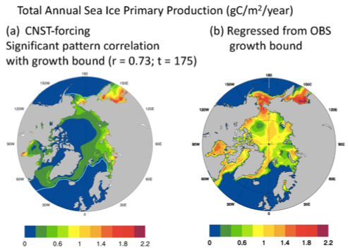
Investigating controls on sea ice algal production using E3SMv1.1-BGC
Objective
Sea ice algae are fundamental sources of primary production (PP) and critical for the survival of many polar fish, mammals & seabirds.
Understanding PP dynamics provides key insights into polar carbon fixation & the ecological integrity and stability of polar regions
Approach
Incorporate into E3SMv1.1 an 8-element sea ice biogeochemical component resolved in 3D.
Analyze 300 years of pre-industrial (CNST-forcing) simulations of E3SMv1.1-BGC to identify & quantify coupled constraints on PP.
Impact
Simulations of polar integrated sea ice PP support the lower bound in published estimates for both polar regions with mean Arctic values of 7.5 and 15.5 TgC/a in the Southern Ocean.
However, comparisons of the polar climate state with observations, using a maximal bound for ice algal growth rates, suggest that the Arctic lower bound is a significant underestimation driven by biases in ocean surface nitrate
Correction of these biases supports as much as 60.7 TgC/a of net Arctic PP.
Mean total annual Arctic primary production (gC/m2/a) in CNST-forcing(a) is significantly correlated with a bound for maximal growth. (b) is an estimate of Arctic PP using the regression coefficient from (a) and the observations based on maximal growth bound. Total integrated Arctic ice PP from (b) is 60.7 TgC/a.
Jeffery N et al. (2020). Investigating controls on sea ice algal production using E3SMv1.1-BGC. Annals of Glaciology 1–22. https://doi.org/10.1017/aog.2020.7

