Slide 1

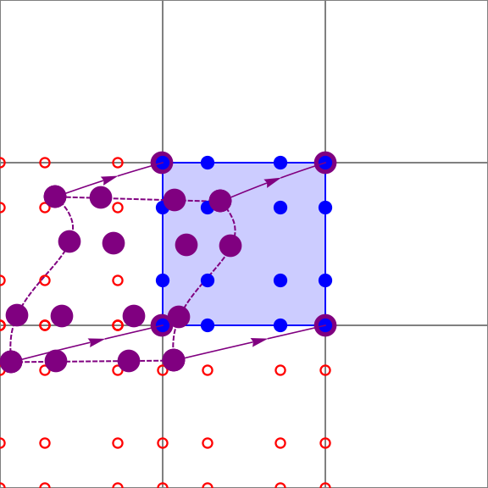

Conservative Multimoment Tracer Transport
Background:
Tracer transport is an important component of global climate models.
Due to the long time scales, the ability to conserve mass is especially important for climate models.
Tracer transport is computationally expensive because the number of tracers can be very high (e.g., > 40).
Next generation computing platforms present new challenges for algorithm design.
Most significant amongst these challenges is the high cost of data movement (communication) within the machine.
Impact:
SLMMIR: Semi-Lagrangian Multimoment Incremental Remap transport algorithm
Local mass conservation
Multitracer efficiency: most of the algorithm is independent of the number of tracers
Parallel: Algorithm design exposes fine-grained parallelism suitable for advanced architectures.
Implementation is 2nd order accurate, but higher orders are possible
Fast: Achieves a 2.2x speedup vs. EAM v1 with 40 tracers at strong scaling limit (1 mesh element per computing core).
Fig. 1. Mesh nodes (blue) are traced back in time (purple) to compute new values.
Goal: Design a conservative transport algorithm for next generation computing architectures.
Approach and results:
Use semi-Lagrangian time stepping to permit large time steps, reducing communication.
Use compact, high order stencils so that a compute node’s required data are available locally
Fig. 2. Normalized computing time for transport vs. number of tracers; EAM v1 spectral element (SE) method, blue; SLMMIR, orange.
Bosler, P.A., Bradley, A.M., & Taylor, M.A. (2019). Conservative multimoment transport along characteristics for discontinuous Galerkin methods. SIAM Journal of Scientific Computing, 41(4), B870—B902.
Sandia National Laboratories is a multimission laboratory managed and operated by National Technology & Engineering Solutions of Sandia, LLC, a wholly owned subsidiary of Honeywell International Inc., for the U.S. Department of Energy’s National Nuclear Security Administration under contract DE-NA0003525.SAND2019-10875 O

