Slide 1
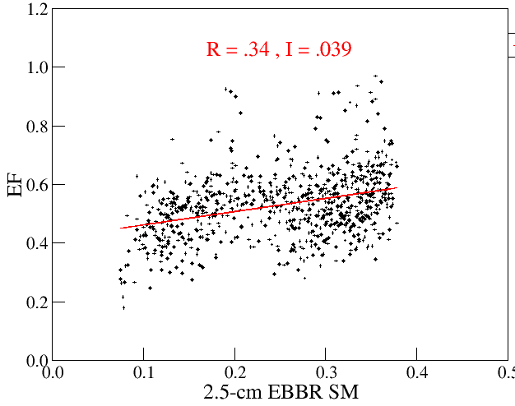
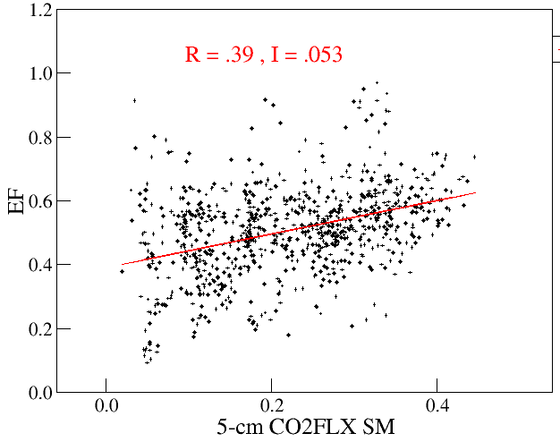
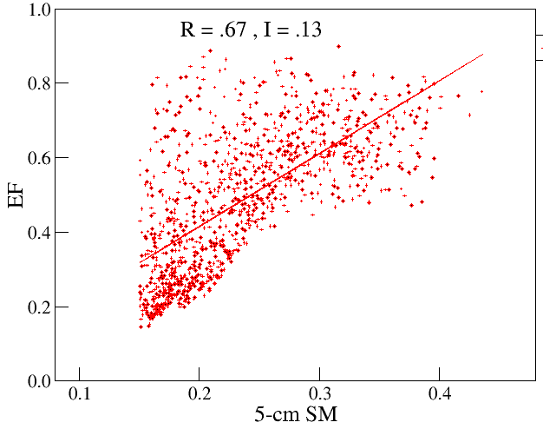
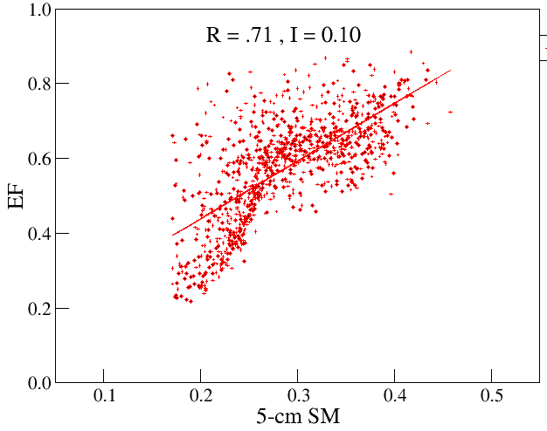
ARM evaluation of model land-atmosphere coupling (LAC)
Objective
Estimate LAC in the U.S. SGP region from ARM observations, then evaluate CAM5.1/CLM4 model LAC in free-running versus controlled simulations
Approach
Compute metrics R and I of LAC coupling strength between ARM soil moisture and surface atmospheric observations at SGP
Compare these field estimates with model-simulated LAC at SGP
Impact
Model LAC is confirmed to be much too strong at SGP
Similar results for free-running and controlled simulations, implying fundamental problems in the model’s coupling mechanisms
Top panels: Scatter of daily averages of ARM-observed surface evaporative fraction EF versus independent shallow-depth soil moisture data sets, with LAC strength metrics R and I shown. Bottom panels: analogous results for free-running and controlled model simulations, respectively. Note model LAC strength metrics are significantly larger than ARM observational estimates.
T.J. Phillips, S.A. Klein, H-Y. Ma, Q. Tang,, S. Xie, I.N. Williams, J.A. Santanello, D.R. Cook, and M.S. Torn, “Using ARM Observations to Evaluate Climate Model Simulations of Land-Atmosphere Coupling on the U.S. Southern Great Plains" (2017) [DOI:10.1002/2017JD027141]
Notes:
Here, LAC strength metric R is the correlation between daily averages of shallow-depth (2.5 cm to 5.0 cm depth) soil moisture SM and the surface evaporative fraction EF (ratio of latent heat flux to latent + sensible heat fluxes). Complementary LAC metric I indicates the amount of change in EF occurring for a one-standard-deviation change in SM.

