Slide 1
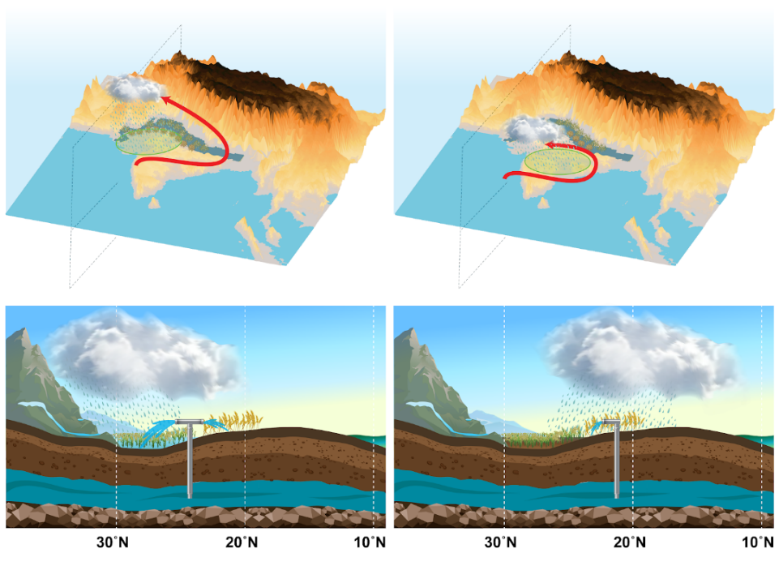
Irrigation Practices affect Monsoon Precipitation
Objective
Understand the effects of land and water management practices on monsoon circulation and extreme rainfall.
Approach
Implement modules into Weather Research and Forecasting model coupled to the Community Land Model version 4 (WRF-CLM4) to represent irrigation, groundwater pumping, and the bio-geophysical effects of flooded paddy fields.
Employ the enhanced WRF-CLM4 to simulate the impact of agricultural water management practices using numerical experiments.
Impact
Confirmed through modeling that excess irrigation over northern India causes a northwestward shift in monsoon rainfall and intensifies widespread extreme precipitation over Central India, consistent with observations.
Demonstrated that it is important to represent land management and irrigation practices accurately in Earth system and weather models.
(a)
(b)
(c)
(d)
Experiments with realistic representation of unmanaged irrigation and paddy cultivation over north-northwest India exhibit an increase in the late season terrestrial monsoon precipitation and intensification of widespread extreme events over Central India (panels a and c), compared to the case in which irrigation is managed based on crop water demand (panels b and d). This finding is consistent with changes in observations.
Devanand A, M Huang, M Ashfaq, B Barik, S Ghosh. 2019. “Choice of Irrigation Water Management Practice affects Indian Summer Monsoon Rainfall and its Extremes.” Geophysical Research Letters, 46 (15): 9126-9135, https://doi.org/10.1029/2019GL083875 .
Notes:
http://www.pnnl.gov/science/highlights/highlights.asp?division=749

