Slide 1
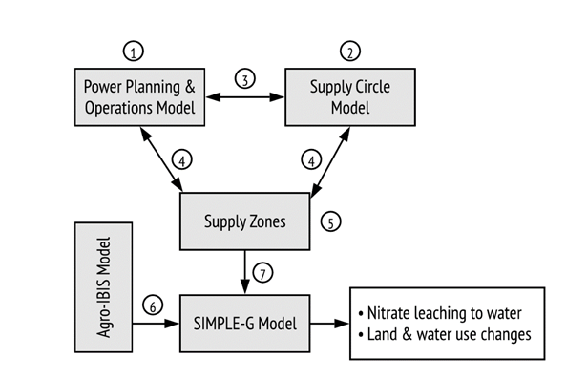
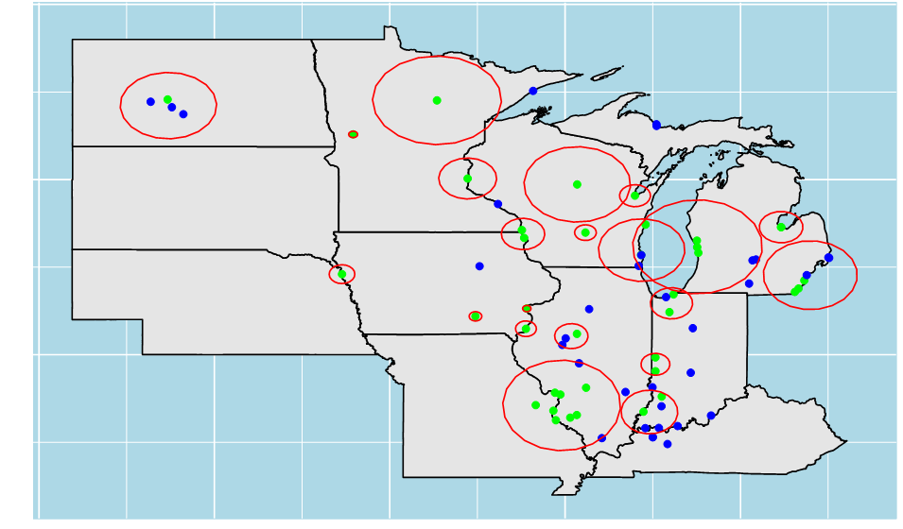
Scale-Aware Analysis of Energy, Land, and Water Systems Dynamics: Nitrate Release Under Scenarios of Biomass Co-Firing in the Midwestern U.S.
Objective
Interdisciplinary research into the multisector dynamics involving energy, land and water systems is increasingly crossing institutional/governance domains and natural and economic systems that have historically been studied independently. A key methodological question concerns the appropriate scale and scope of analysis. Most studies employ either: 1) a high-level model that resolves multiple systems at relatively coarse scale; or 2) a model or empirical analysis with a finer scale resolution focused on the primary system of interest. However, it may be necessary to bridge these two approaches. Understanding when this is required is a critical research question.
Impact
Scientists confront a critical question of scale for their analysis of linkages between energy, water and land systems. Studies exploring this nexus within a single watershed or an individual power plant can accurately capture local processes. However, when interventions are extrapolated to a regional scale, critical multisector dynamics are missed. We find that forty-six percent of the coal-fired plants in the upper-MISO region stop generating electricity instead of co-firing biomass at the 15% level. Ignoring these interactions leads to overestimation of the demand for biomass. On the other hand, region-wide analysis of this nexus grossly underestimates the impact on water quality in key hotspots of the MISO region.
Approach
This study applies a novel, gridded energy-land-water modeling system to analyze the local environmental impacts of corn residue co-firing of coal power plants across the upper MISO region.
Figure: Coal-fired power plants and biomass supply circles
Sun, Shanxia, Brayam Valqui Ordonez, Mort D. Webster, Jing Liu, Christopher J. Kucharik, and Thomas Hertel. 2020. “Fine-scale Analysis of the Energy-Land-Water Nexus: Water Quality Implications of Biomass Co-Firing in the Midwestern U.S.”, Environmental Science and Technology https://doi.org/10.1021/acs.est.9b07458.

