Slide 1
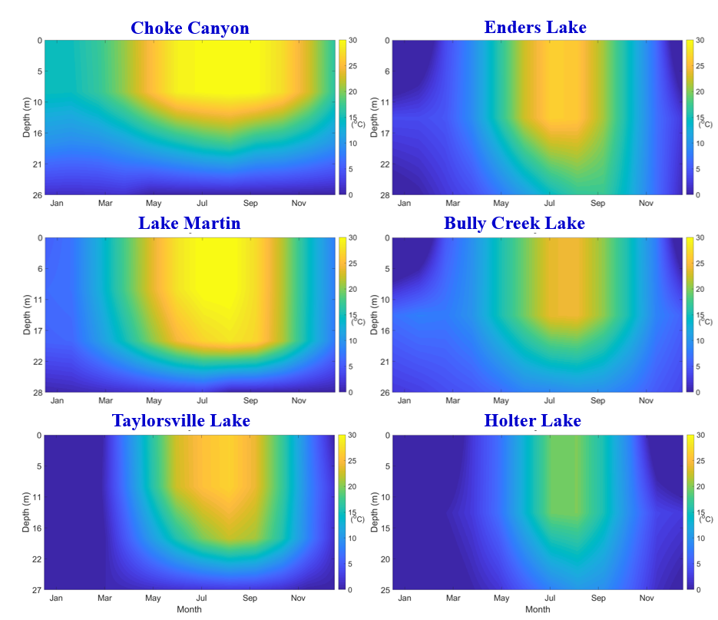
Reservoir Stratification Module for Earth System Models
Objective
Develop a module to improve Earth system modeling of temperature changes in reservoirs and effects on stream temperature
Approach
Formulate one-dimensional heat equation to account for reservoir inflow and outflow processes, as well as variations in reservoir storage area
Solve modified equation to estimate temperature at various reservoir depths
Validate model using observed surface, profile, and outflow temperatures
Impact
Developed framework for including reservoir temperature stratification to better represent stream temperature in Earth system models at regional, continental, and global scales
Improved estimation of reservoir outflow temperature by including reservoir stratification information
Different processes in a reservoir contribute to the variation in temperature at different depths at a given time.
Improved outflow temperature estimation for Lake Powell between the years 2005 and 2007.
Yigzaw W, Li HY, Fang X, Leung LR, Voisin N, Hejazi MI, and Demissie Y. 2019. “A Multi‐layer Reservoir Thermal Stratification Module for Earth System Models.” Journal of Advances in Modeling Earth Systems, https://doi.org/10.1029/2019MS001632.
Notes:
http://www.pnnl.gov/science/highlights/highlights.asp?division=749

