Slide 1
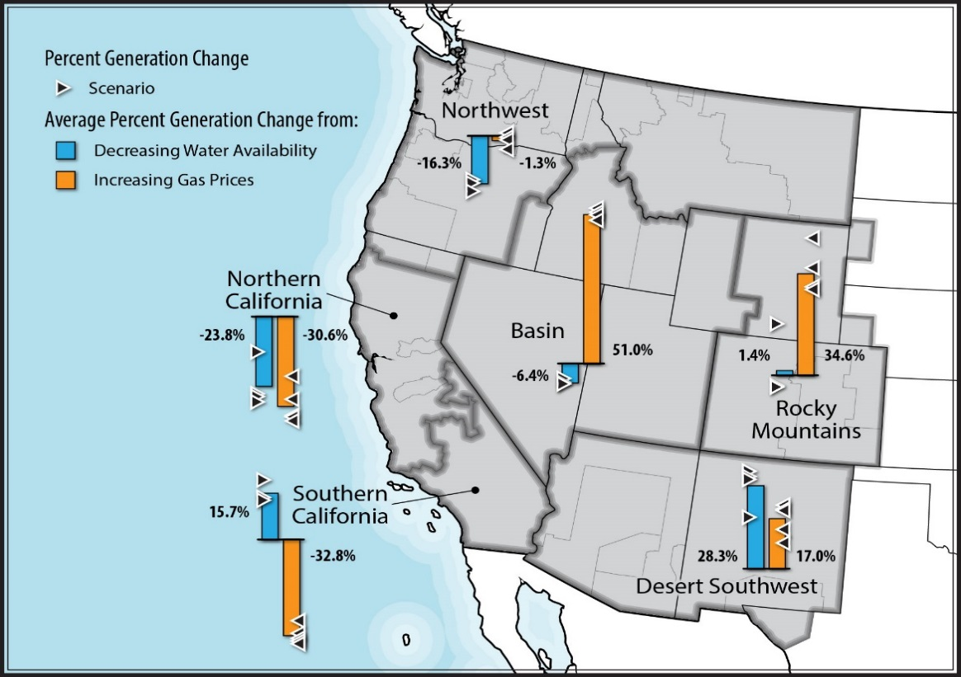
Sensitivity of Western U.S. Power System Dynamics to Droughts Compounded with Fuel Price Variability
Objective
Use innovative model coupling across sectors to understand tradeoffs and tipping points of water-related stresses compounded with stresses related to fuel price volatility for the western U.S. power grid
Approach
Apply high-resolution power system model simulations to identify a range of water availability cases
Combine hydrology scenarios with four separate natural gas price scenarios to capture historical and future price volatility
Evaluate power system impacts and regional trends using high-resolution production cost model
Impact
Research sheds light on the tradeoffs and tipping points of water-related stresses compounded with stresses related to fuel price volatility
Study reveals that water-related stresses can have the same magnitude of impacts on grid operations as natural gas price volatility
Regional responses to simultaneous stresses can augment or offset stresses analyzed in isolation
The map indicates the sensitivity of western U.S. power system generation to droughts compounded with fuel price variability. Analysis of six major subregions showed that the effects of water availability and fuel prices could be of the same magnitude and that the sensitivity to drought versus higher gas prices depends on the sub-regional generation mix.
O’Connell M, N Voisin, J Macknick, and T Fu. 2019. “Sensitivity of Western U.S. Power System Dynamics to Droughts Compounded with Fuel Price Variability.” Applied Energy 247:745–754, https://doi.org/10.1016/j.apenergy.2019.01.156.
Notes:
http://www.pnnl.gov/science/highlights/highlights.asp?division=749

