Slide 1
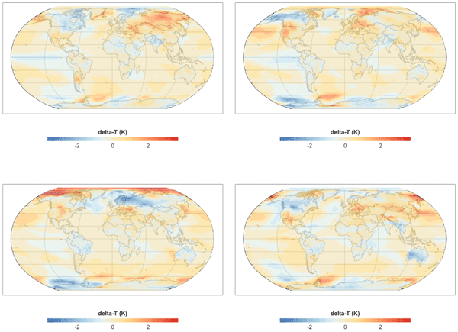
Fldgen v. 1.0: An Earth System Model Emulator
Objective
Develop an Earth system model (ESM) emulator that captures the internal variability and correlations over space and time that are seen in ESM output.
Approach
Analyze ESM output for correlation structure over space and time.
Perform spectral decomposition on spatial modes.
Randomize the phases of the spectral decomposition.
Reconstruct a field of climate variables that will have the same space and time correlation structure as the input ESM data.
Repeat Randomize and Reconstruct steps as many times as desired to produce alternate realizations of the climate variables.
Impact
Fldgen v.1.0 can enable research into uncertainties in climate impacts by allowing researchers to estimate what an ESM would have produced.
Subsequent versions—already developed and under scientific review—include additional variables such as precipitation, making it possible to study a wider range of extreme event risks.
PNNL’s fldgen ESM emulator allows researchers to estimate what would have happened if they had been able to run a large ensemble of ESM runs.
Link R, A Snyder, C Lynch, C Hartin, B Kravitz, and B Bond-Lamberty. 2019. “Fldgen v1.0: an emulator with internal variability and space-time correlation for Earth system models.” Geosci. Model Dev., 12:1477-1489, https://doi.org/10.5194/gmd-12-1477-2019.
Notes:
http://www.pnnl.gov/science/highlights/highlights.asp?division=749

