Slide 1
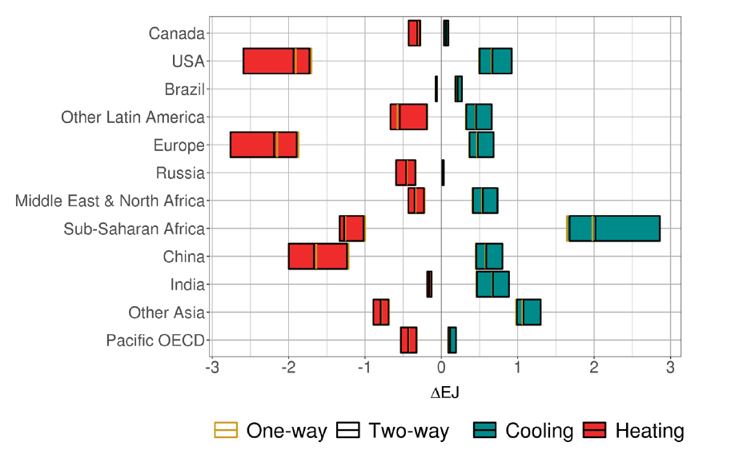
Quantifying Feedbacks Between Energy Demand and Climate
Objective
Quantify the effect of human–Earth system feedbacks via changes in energy demand and its associated emissions.
Approach
Explore a wide range of climate and socioeconomic uncertainties and incorporate human–Earth system feedbacks within the Global Change Analysis Model.
Quantify the implications of a changing climate on energy demand and subsequent emissions, as well as how those changes feedback on climate.
Impact
Changes in climate lead to increases in cooling demand and declines in heating demand.
Incorporating two-way feedbacks between human and Earth systems results in a small increase in projected global mean temperature.
While the feedback magnitude is small in this example, this study demonstrates how to incorporate these types of feedbacks in a single internally consistent model.
Changes in heating and cooling energy demand from the reference. Including climate feedbacks decreases heating demand and increases cooling demand. Adding the two-way feedbacks causes a small amplification in the effects.
C. Hartin, R. Link, P. Patel, A. Mundra, R. Horowitz, K. Dorheim, and L. Clarke. “Integrated Modeling of Human-Earth System Interactions: an Application of GCAMFusion.” Energy Economics, 103, 105566, (2021). [DOI: 10.1016/j.eneco.2021.105566].

