Slide 1
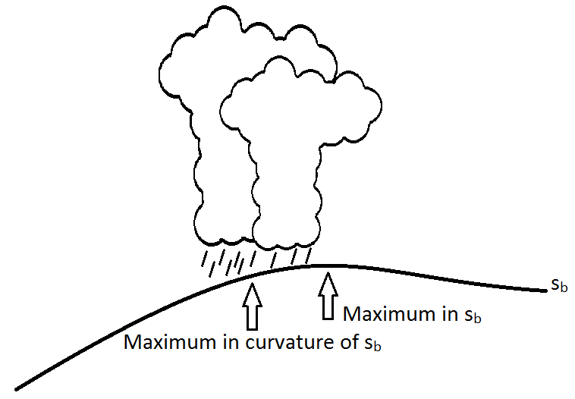
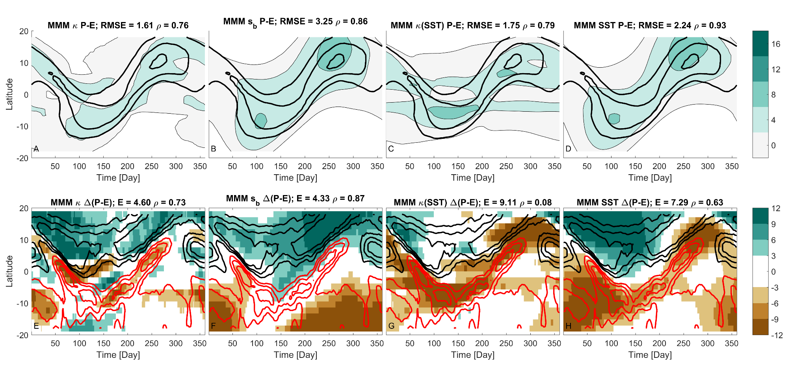

Strength and Location of Tropical Rain Belt Depend on Spatial Distribution of Surface Moist Entropy
Objective
Leverage Convective Quasi-Equilibrium theory to predict changes in seasonal evolution of the Intertropical Convergence Zone (ITCZ) under warming
Approach
Build a linear model relating net precipitation [precipitation minus evaporation (P-E)] to the curvature of the surface moist entropy field (s_{b})
Use changes in s_{b} to predict changes in P-E with warming in a series of aquaplanet experiments
Diagnose moist static energy budget to propose a theory for the linear relationship between P-E and s_{b}
Impact
ITCZ follows the maximum curvature of s_{b} throughout the year, even during transition seasons (when other measures often lack skill)
Changes in s_{b} accurately predict changes in P-E for various models under warming
This work highlights the role of transient eddies in moving energy out of the tropics and suggests that these features give rise to the linear relationship between s_{b} and P-E
The tropical rain belt is co-located with the maximum curvature of the surface moist entropy field throughout the year.
P-E [mm/day]
Δ(P-E) [mm/day]
Day of the year
Day of the year
Left: P-E predicted by the curvature metric (colors) correlates well with the seasonal progression of the ITCZ (contours) for the multi-model mean (MMM). Right: Changes in P-E predicted by the curvature metric (colors) are also well correlated with changes in P-E (contours) associated with the ITCZ.
Harrop BE, J Lu, and LR Leung. 2019. “Sub-cloud moist entropy curvature as a predictor for changes in the seasonal cycle of tropical precipitation.” Climate Dynamics, accepted, https://doi.org/10.1007/s00382-019-04715-2.
Notes:
http://www.pnnl.gov/science/highlights/highlights.asp?division=749

