Slide 1
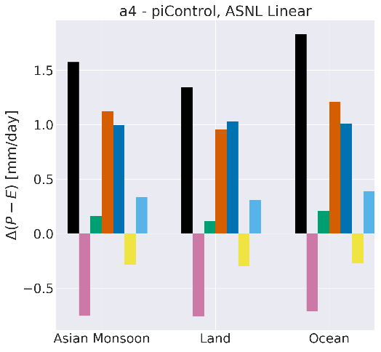
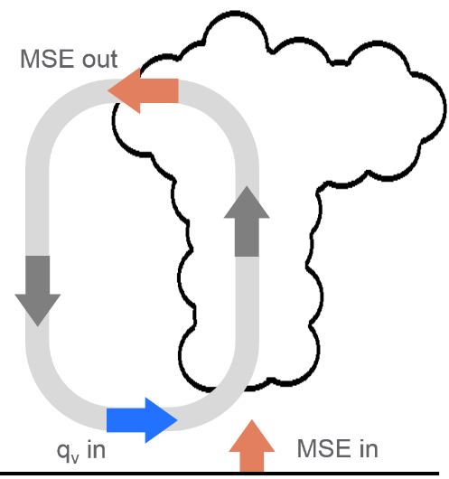
A New Perspective on the Asian Summer Monsoon
abrupt4xCO2 - piControl
Objective
Evaluate the Asian Summer Monsoon (ASM) and its response to warming
Approach
Used the link between the flow of energy and moisture in the atmosphere—a relationship termed the normalized gross moist stability (NGMS)—to fingerprint the physical processes responsible for the increased rainfall with warming predicted by the model
Employed DOE’s Energy Exascale Earth System Model to demonstrate the value of the NGMS framework for understanding the model-predicted monsoon response to warming
Impact
The new diagnostic approach confirmed established processes and uncovered the role of NGMS on monsoon rainfall sensitivity to warming
Active ocean circulation was shown to be an important feature for robust circulation response
Atmospheric moisture loading is a key component to changes in NGMS with warming
The NGMS framework provides a fingerprint of the monsoon, which highlights the importance of NGMS itself for the increase in rainfall due to warming
Harrop B.E., P.-L. Ma, P.J. Rasch, Y. Qian, G. Lin, C. Hannay. 2019. “Understanding Monsoonal Water Cycle Changes in a Warmer Climate in E3SMv1 Using a Normalized Gross Moist Stability Framework.” Journal of Geophysical Research: Atmospheres, DOI: 10.1029/2019JD031443
Notes:
http://www.pnnl.gov/science/highlights/highlights.asp?division=749

