Slide 1
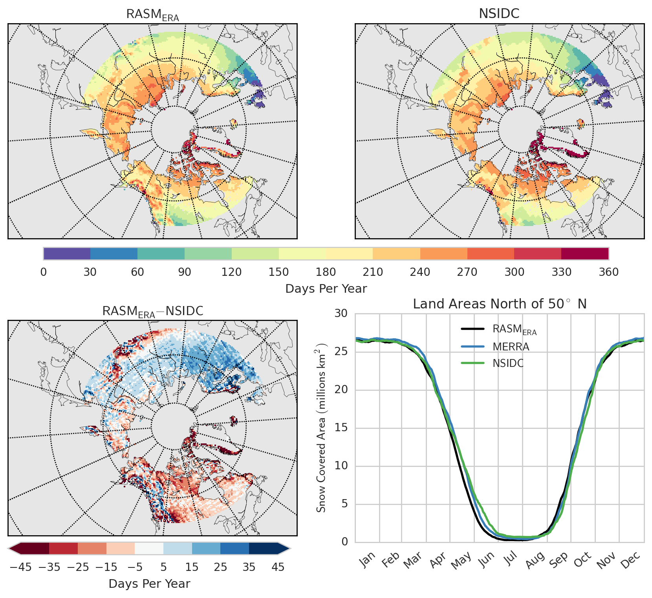
Land Surface Climate in the
Regional Arctic System Model
Objective
Present the baseline land-surface climate in the recently developed Regional Arctic System Model (RASM). Identify areas where the RASM land surface scheme is performing well and areas for future development.
Approach
Use the fully-coupled Regional Arctic System Model (RASM) to evaluate the performance of the land surface scheme (the Variable Infiltration Capacity [VIC] model) relative to a range of observation, remote sensing and model based datasets.
Assess RASM’s ability to represent the first order behavior of Arctic land surface processes such as the seasonal cycle of snow, the differences between the tundra and taiga in terms of turbulent heat fluxes, and the partitioning of precipitation into evaporation and runoff.
Impact
This work introduced a novel coupling of the VIC model within a coupled Earth System Model. In the process of validating the VIC model, we identified areas where both global reanalyses and RASM could be improved, namely in the simulation of turbulent heat fluxes and runoff generation.
Number of snow-covered days per year for (top left) RASM and a remote sensing product from the National Snow and Ice Data Center (NSIDC; top right). Difference between numbers of snow-covered days per year (bottom left). Annual cycle of snow-covered area north of 50°N (bottom right). Time period is September 1989–August 2014.
Hamman, J., B. Nijssen, M. Brunke, J. Cassano, A. Craig, A. DuVivier, M. Hughes, D.P. Lettenmaier, W. Maslowski, R. Osinski, A. Roberts, and X. Zeng, 2016: Land surface climate in the Regional Arctic System Model. Journal of Climate, doi:10.1175/JCLI-D-15-0415.1.

