Slide 1
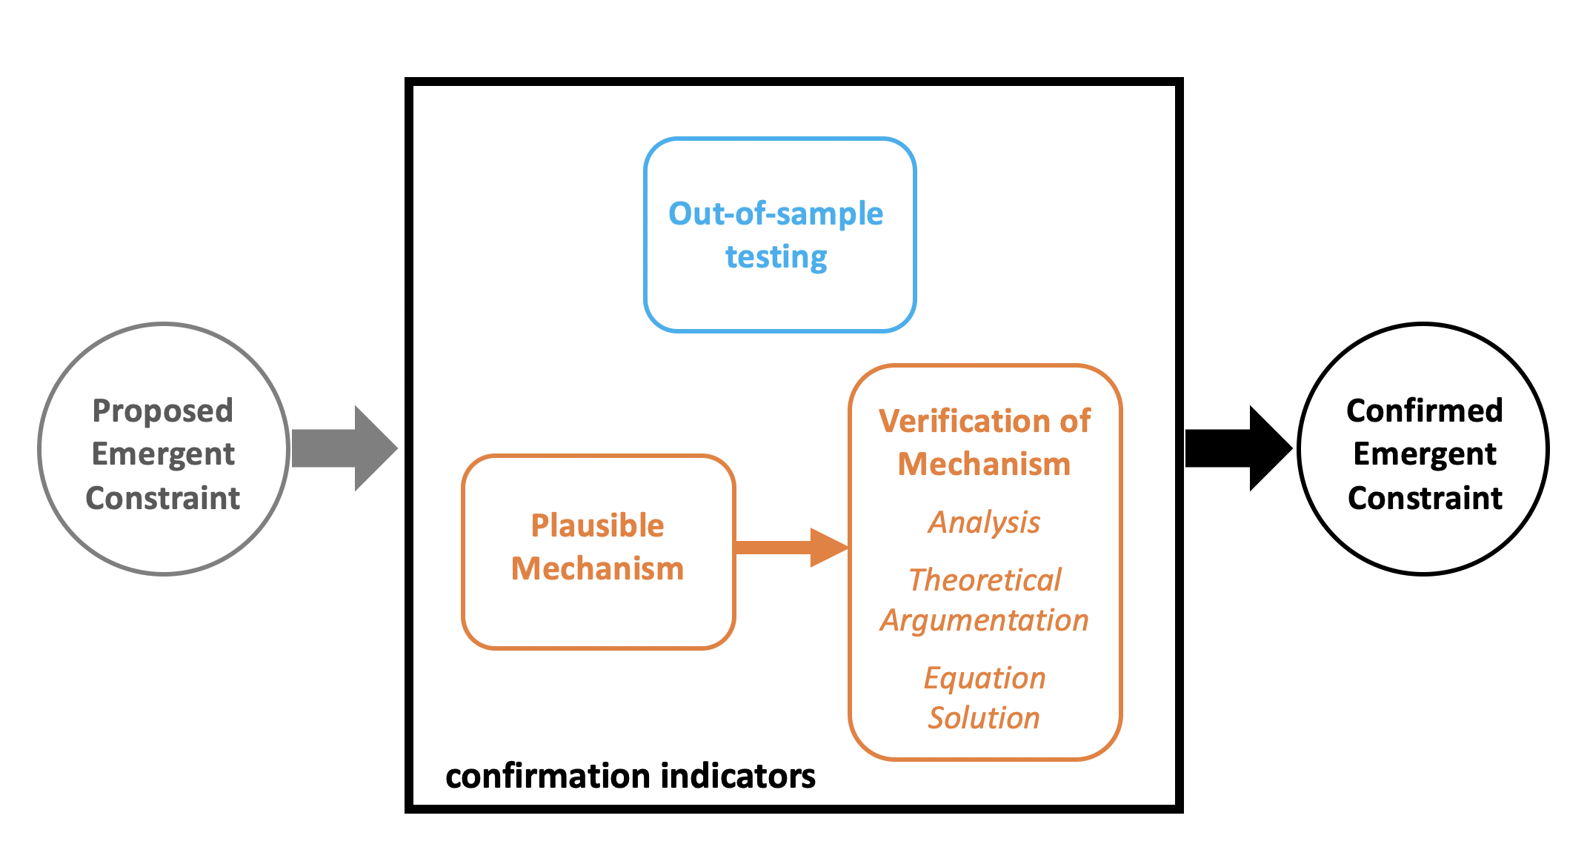
Progressing Emergent Constraints on Future Climate Change
Objective
Articulate a framework to assess Emergent Constraints, and provide indicators whereby a proposed EC may move from a strong statistical relationship to confirmation.
Approach
Discuss why Emergent Constraints might exist in ESM ensembles.
Provide indicators that Emergent Constraints are physical and not just statistical.
Describe the circumstances under which Emergent Constraints can be used for uncertainty reduction now.
Suggest new directions for Emergent Constraint research.
Impact
This paper provides a means of evaluating whether Emergent Constraints are “real”, and lays out a path forward for Emergent Constraint research.
Illustration of the confirmation process for Emergent Constraints. Confirmed Emergent Constraints are associated with indicators that a mechanism underpins the emergent relationship. A plausible mechanism for an emergent relationship can launch an Emergent Constraint along the confirmation process. The mechanism can then be verified through analysis, theoretical argumentation, or equation solution. In parallel, out-of-sample testing is an indirect empirical method for ascertaining the likelihood that an emergent relationship is underpinned by a mechanism.
Hall A, Caldwell P, Huntingford C, and S Klein, “Progressing Emergent Constraints on Future Climate Change” Nature Climate Change. DOI: 10.1038/s41558-019-0436-6
Notes:
http://www.pnnl.gov/science/highlights/highlights.asp?division=749

