Slide 1
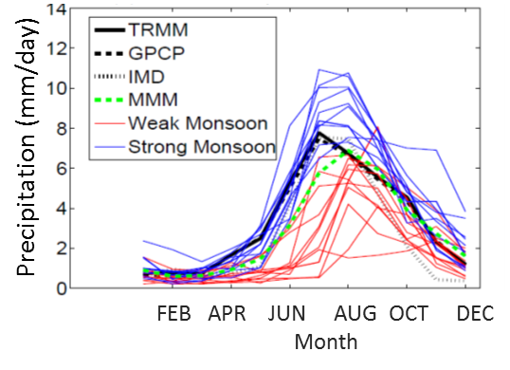
A Link Between Uncertainty Over Tropical Oceans
and Bias in Modeling South Asian Monsoon Rainfall
Objective
Understand the origin of the dry bias and inter-model spread in South Asian monsoon precipitation simulated by CMIP5 models
Approach
Use moisture and energy budget analyses to derive a nonlinear relationship between the column total water vapor and precipitation over the tropical Indian Ocean
Use the nonlinear relationship to diagnose the origins of the CMIP5 model biases and inter-model spread
Impact
Showed that inter-model spread (uncertainty) and mean bias are intimately linked by nonlinear moist processes
Pinpointed the representation of moist convection processes in Earth system models as the main source of dry bias in simulating the South Asian monsoon precipitation
Results suggest that model projections of future changes in monsoon precipitation are likely overestimated
Comparison of the seasonal cycles of precipitation over India from CMIP5 models and observations shows a large inter-model spread and a mean dry bias. Observations are shown in black solid and dashed lines, individual model simulations are shown in blue and red lines, and multi-model mean is shown in green.
Relationship between precipitation and column water vapor over the tropical Indian Ocean. The open and closed markers represent present-day and future CMIP5 simulations, respectively. Different colors represent different CMIP5 models.
Precipitation (mm/day)
Column water vapor (cm)
Hagos S, LR Leung, M Ashfaq, and K Balaguru. 2018. “South Asian Monsoon Precipitation in CMIP5: A Link Between Inter-Model Spread and the Representations of Tropical Convection.” Climate Dynamics, early online. https://doi.org/10.1007/s00382-018-4177-4
Notes:
The Far-Reaching Effects of Tropical Moist Air
Researchers uncover a nonlinear relationship between South Asian monsoon rainfall and water vapor over the tropical Indian Ocean in Earth system models.
The Science
Earth system models often struggle to accurately simulate precipitation from the South Asian monsoon and the processes that drive it. For example, Coupled Model Intercomparison Project Phase 5 (CMIP5) models exhibit a mean dry bias—a tendency toward dryness—and a large spread among models in the simulated monsoon precipitation. Scientists at the U.S. Department of Energy’s Pacific Northwest National Laboratory led a study showing that the dry bias and inter-model spread in CMIP5 models are a consequence of a nonlinear relationship between precipitation and water vapor. Results also suggest that the model bias likely causes an overestimation of the monsoon rainfall response to warming.
The Impact
The South Asian monsoon supplies a large population with water for food production, energy generation, and other economic activities. Understanding the physical processes that control the monsoon and its response to warming could help improve modeling and prediction of the monsoon system and in turn inform water planning and management efforts. In particular, this study highlights the need for better representation of tropical moist convection in Earth system models.
Summary
To improve understanding of the origins of the dry bias and inter-model spread in CMIP5 simulations, researchers examined 21 global models, three reanalyses (model-data products), and observations. They found that because of the nonlinear relationship between precipitation and water vapor in the atmosphere over the tropical Indian Ocean, simulations with more water vapor over the ocean contributed disproportionately to the weaker South Asian monsoon and large inter-model spread.
On the other hand, models that simulated less water vapor more closely matched observations of monsoon precipitation. These models also indicated monsoon precipitation is less sensitive to future warming, suggesting that the multi-model mean projection of future monsoon changes is likely overestimated. Importantly, this study identified the relationship between the vertical distribution of wind convergence and moisture, which depends on how models represent moist convection, as a key metric for understanding model biases and differentiating model skill in simulating the South Asian monsoon precipitation.

