Slide 1
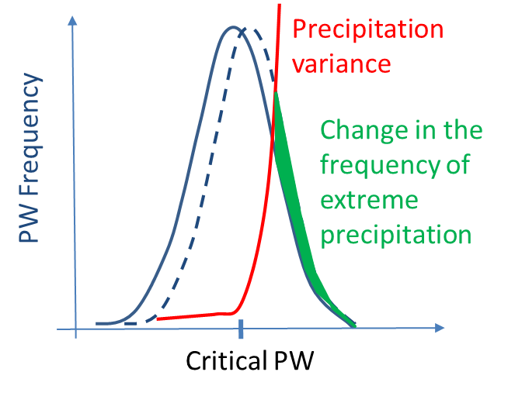
How Small-Scale Processes in Clouds Influence Large-Scale Precipitation Variability and Extremes
Objective
Investigate the cross-scale influence of in-cloud microphysical processes on large-scale precipitation variance and frequency of extreme rainfall
Approach
Using the convection-permitting Model for Prediction Across Scales-Atmosphere (MPAS-A), perform statistical analysis on simulations of a Madden-Julian Oscillation episode with perturbed cloud microphysical parameters
Evaluate simulations against radar observations from the Dynamics of the Madden-Julian Oscillation (DYNAMO) field campaign
Impact
New theory links in-cloud microphysical processes to large-scale precipitation variability and extremes in climate simulations
Theory inspired an approach to estimate difficult-to-observe, small-scale cloud microphysical parameters using readily available observations of large-scale precipitation variability
Because precipitation variance is non-linearly related to precipitable water (PW), the frequency of extreme precipitation is very sensitive to microphysical parameters that shift the precipitable water statistics relative to a critical value.
The frequency of extreme precipitation is linearly related to the difference between the mean value and the critical value of PW.
Hagos S, LR Leung, C Zhao, Z Feng, and K Sakaguchi. 2018. “How Do Microphysical Processes Influence Large-Scale Precipitation Variability and Extremes?” Geophysical Research Letters 45:1661-1667. DOI: 10.1002/2017GL076375
Notes:
http://www.pnnl.gov/science/highlights/highlights.asp?division=749

