Slide 1
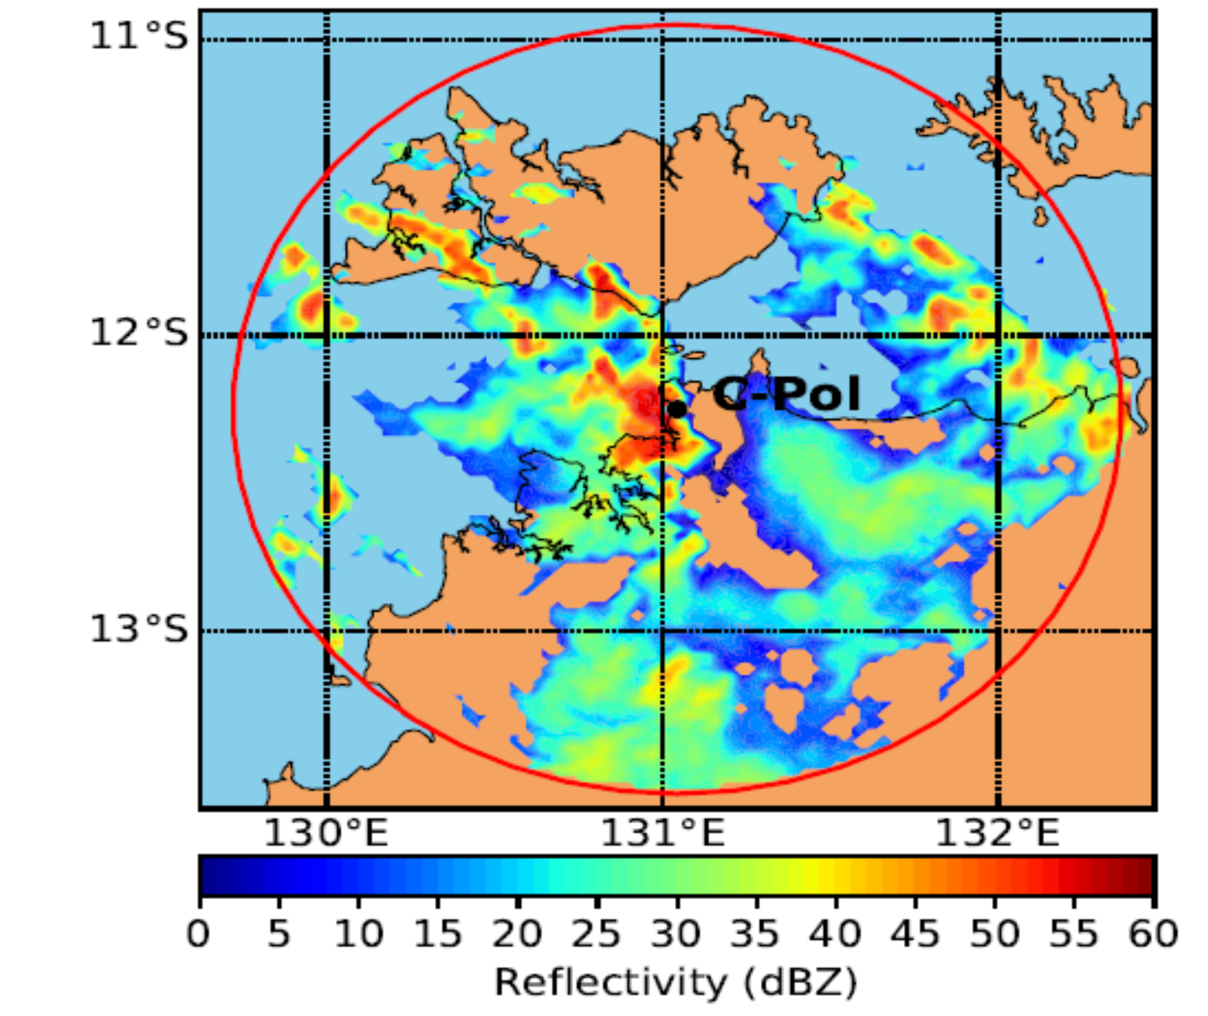
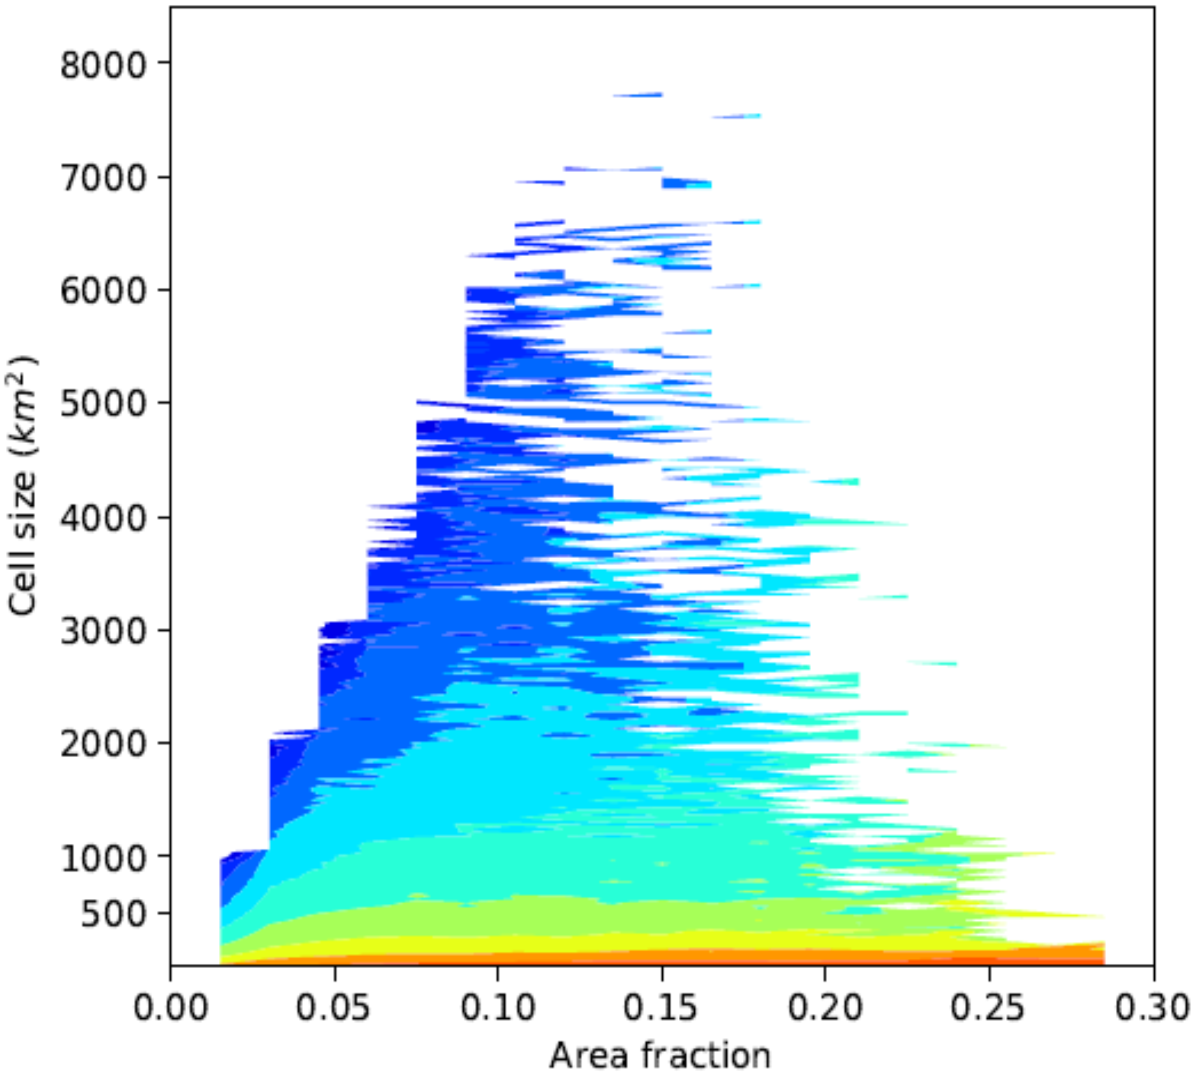
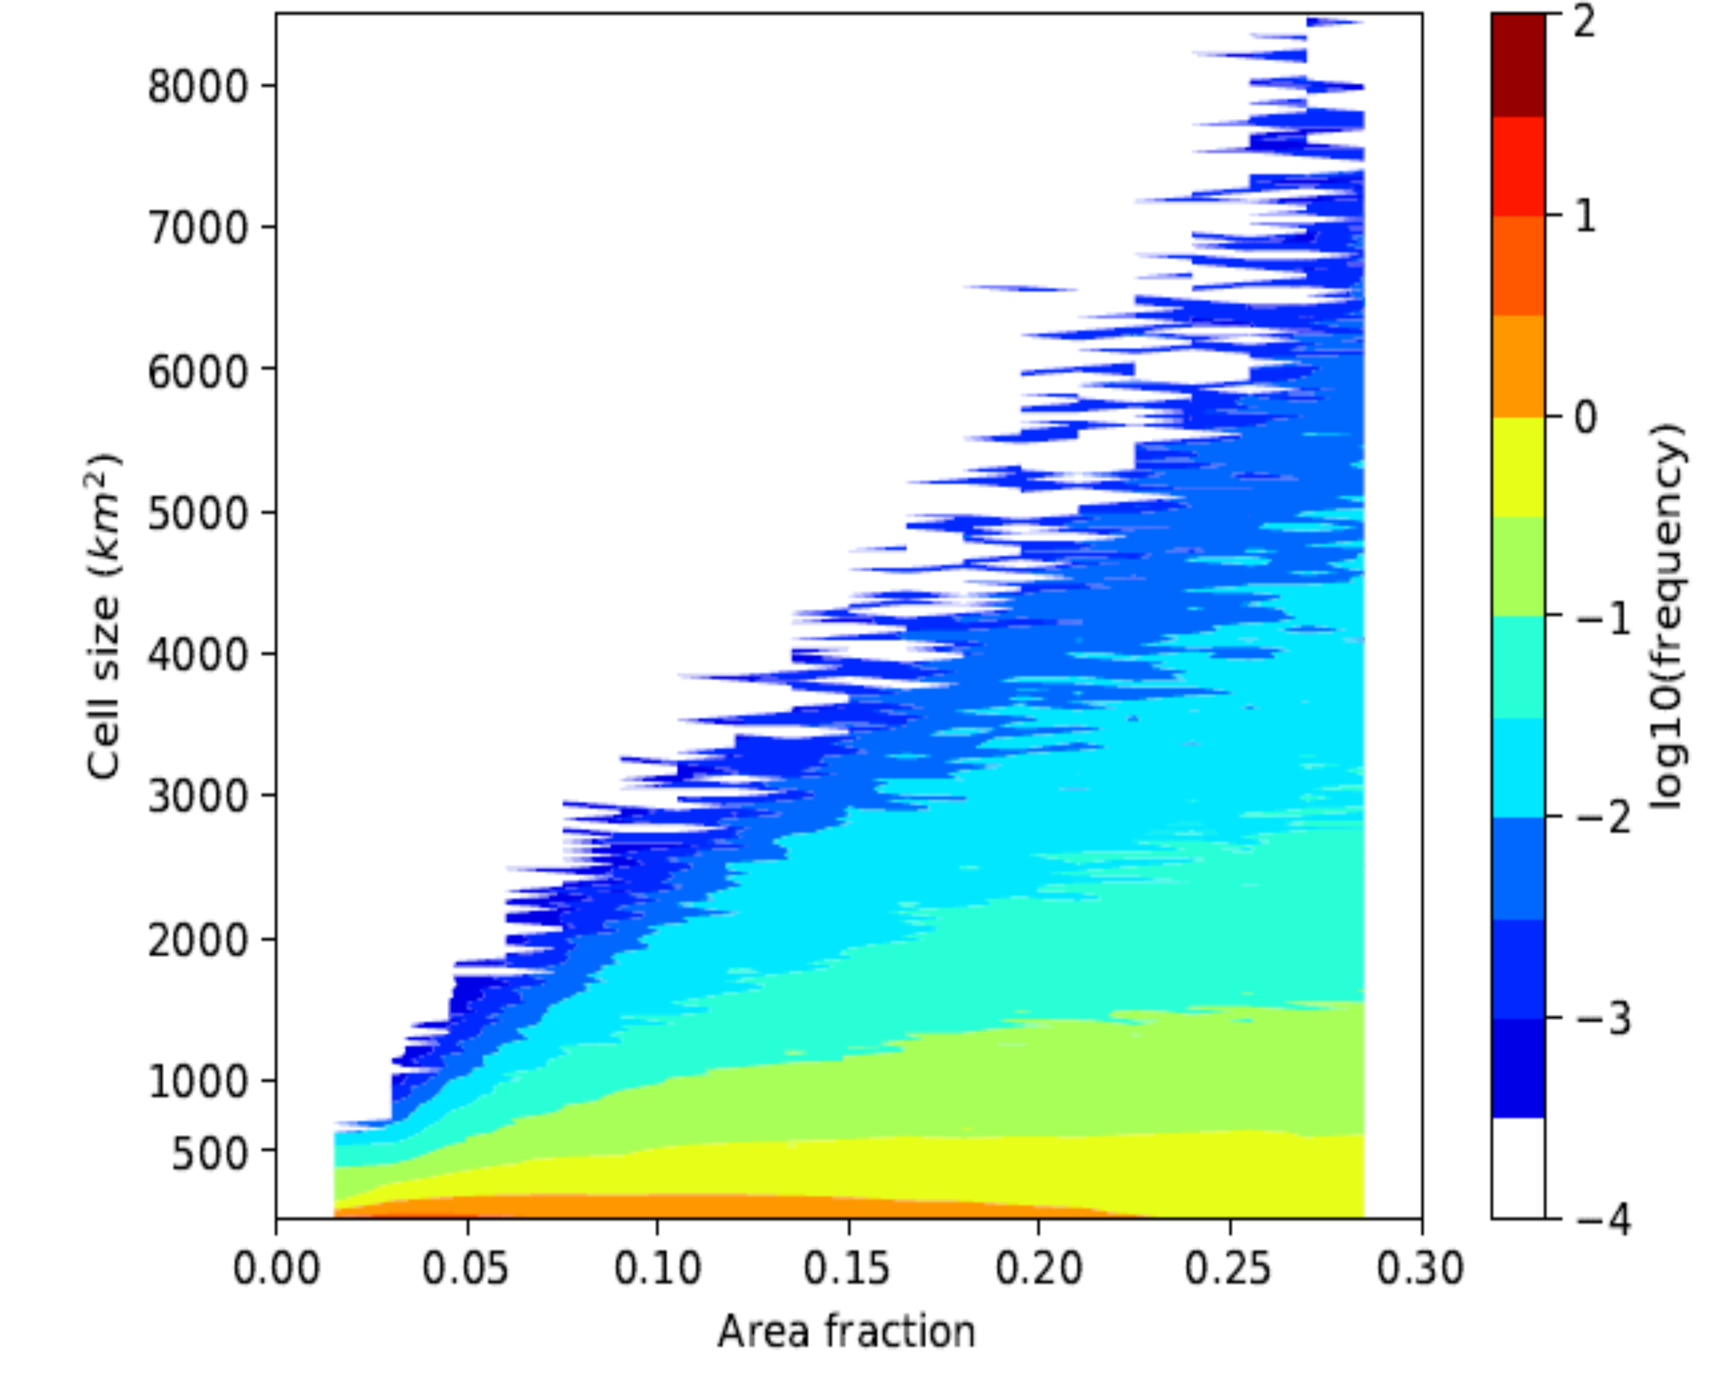
A New Approach to Modeling Convective Clouds
Objective
Develop a parameterization of convective clouds that represents the size continuum of convective clouds, interactions among clouds, and their evolution over time
Approach
Use the Master Equation approach from non-equilibrium statistical mechanics to model the growth and decay of convective cloud populations
Evaluate the performances of the simplified probabilistic models against radar observations and convection-permitting model simulations
Impact
New framework is designed to improve the understanding of cloud-cloud and cloud-environment interactions, and enable their representation in climate and weather models
Study demonstrates the potential of the probabilistic approach to represent the evolution of convective cloud systems
TOP: Convective cells observed by a C-band polarimetric (C-POL) radar at Darwin, Australia.
BOTTOM: Comparison of the radar observation and probabilistic model representation of convective cloud size distribution.
C-POL Radar Observation
Stochastic Model
Hagos S, Z Feng, RS Plant, RA Houze Jr., and H Xiao. 2018. “A Stochastic Framework for Modeling Population Dynamics of Convective Clouds.” Journal of Advances in Modeling Earth Systems 10. DOI: 10.1002/2017MS001214
Notes:
Researchers developed a probability-based framework for representing storm clouds and rainfall in climate models.
The Science
As the resolution of climate and weather models continues to improve, researchers can zoom in and see finer details of cloud processes across space and time. Because clouds are often much smaller than the grid size, existing model representations of intense storm clouds include several assumptions that are not correct for the new generation of models. Using radar observations and convection-permitting models, scientists at the U.S. Department of Energy’s Pacific Northwest National Laboratory led the development of a new probability-based framework for representing convective storm clouds and rainfall in current and future generations of climate models.
The Impact
The proposed framework holds promise for addressing several challenges and biases in climate models related to cloud size, interactions among clouds, and evolution. This could lead to more accurate models representing the inner workings and evolution of convective storm systems, and better predictions of clouds, rainfall, and global circulation.
Summary
Key challenges in the treatment of convective clouds in climate and weather models include representing the size continuum of convective clouds, interactions among clouds, and the evolution of clouds over time. To address these challenges, researchers proposed a novel framework for developing more realistic cloud parameters. Based on the Master Equation, a probability formulation for population dynamics, the framework predicts the growth and decay of the number of convective clouds of a given size.
Under this framework, researchers analyzed observations and used theoretical arguments to build simplified cloud population models. They then evaluated the performance of the simplified models against radar observations and convection-permitting models. The results demonstrated the potential of this probability-based approach to represent the evolution of convective cloud systems, such as internal fluctuations and diurnal cycle. Future work will involve generalizing this approach to include physical processes such as cold pools and stratiform cloud formation, followed by implementation and testing in a climate model.

