Slide 1
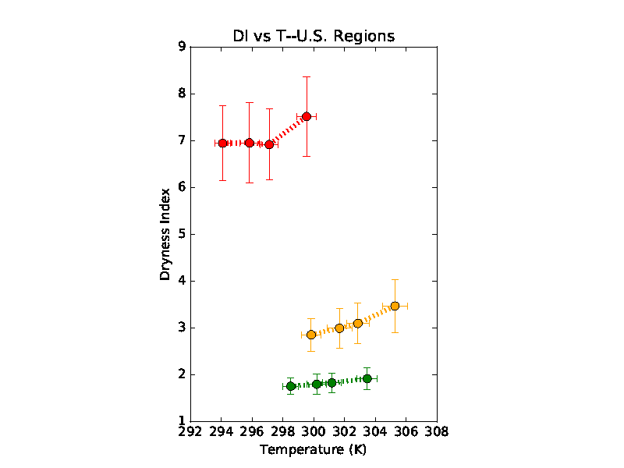
Projecting U.S. regional hydroclimates under greenhouse warming
Objective
To estimate projected future greenhouse-induced hydroclimatic changes in 3 diverse U.S. Southern Tier regions
Approach
Employ ensembles of CMIP5 simulations of 1776-2005 historical climate and projections of future climates under 3 progressively more severe greenhouse emissions scenarios
Compute ensemble-mean (“consensus”) values of various hydroclimatic quantities and inter-model uncertainties, weighted by individual model resolution
Calculate 10x10-degree area-averages of these consensus values over the U.S. Southwest, Southern Great Plains, and Southeast regions, and plot these with respect to surface temperatures
Impact
There is general increase in projected drying of the selected regions across the RCP greenhouse emissions scenarios
The severity of this aridification varies by region, being proportionately greatest in the U.S. SW and SGP, and least in the SE
SW
8.5
2.6
H
4.5
SGP
8.5
4.5
H
2.6
SE
8.5
2.6
4.5
H
CMIP5 ensemble-mean area-averaged Dryness Index for the climatologically arid U.S. Southwest (SW), semi-arid Southern Great Plains (SGP), and humid Southeast (SE) regions, plotted with respect to surface Temperatures for the 1976-2005 historical (H) and 2070-2099 future RCP2.6, RCP 4.5, and RCP8.5 green- house emissions scenarios. Estimated inter-model uncertainties in Temperature and Dryness Index are indicated by horizontal and vertical error bars.
Phillips, T.J., C.J.W. Bonfils, and C. Zhang, 2018, Model consensus projections of U.S. regional hydroclimates under greenhouse warming, Environmental Research Letters 14(2019)014005, doi: https://doi.org10.1088/1748-9326/aaf03d

