Slide 1
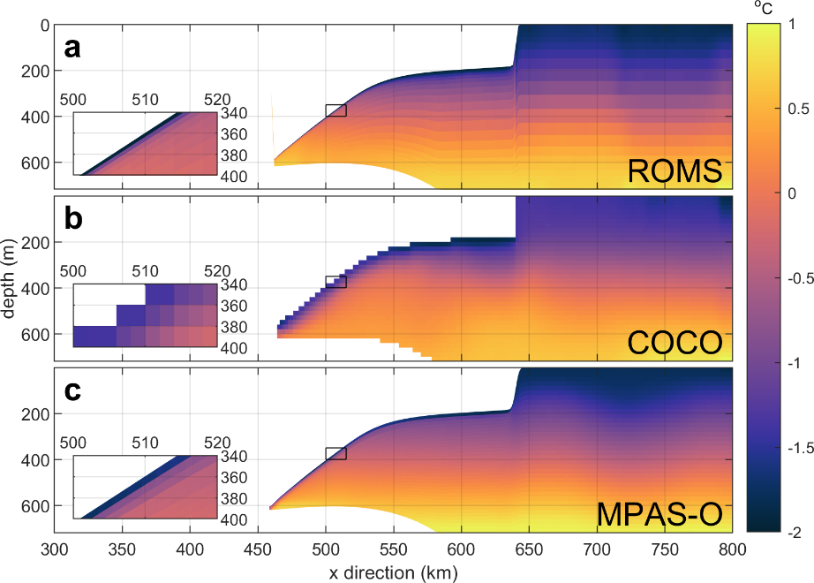
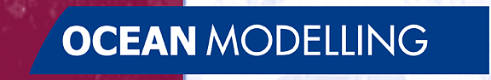
Choice of vertical coordinates impacts ice-shelf basal melting
Objective
  Results from the Marine Ice Sheet-Ocean Model Inter-
  comparison Project (MISOMIP) suggest that ocean models with
  different vertical discretizations produce significantly different
  melt rates in idealized simulations of the cavities under ice
  shelves.
  Using three models that participated in MISOMIP, this work
  explores the relevant differences in vertical resolution and
  boundary-layer parameterization that explain these differences.
New Science
  Models with high vertical resolution near the ice-ocean
  boundary are shown to produce a thin boundary layer and low
  melt rates unless the model explicitly attempts to thicken the
  boundary layer.
  With current boundary-layer parameterizations, a melt rate
  independent of vertical resolution can only be achieved by
  fixing the thickness of the boundary layer to a constant value,
  independent of resolution.
  However, the behavior of the boundary layer is not known to a
  degree that this thickness can be determined from the resolved
  model physics.
Significance
  Current parameterizations of boundary-layer physics likely need
  to be updated or replaced based on observations and high-
  resolution process modeling if ocean models are to produce
  robust, reliable estimates of ice-shelf melting.
The representation of ocean temperature in the ocean cavity under an ice shelf in three ocean models (ROMS, COCO and MPAS-Ocean) with different vertical coordinates and boundary-layer parameterizations. The inset shows that melt water with colder temperature is distributed over significantly different thicknesses in the models.
Citation - Gwyther, D. E., K. Kusahara, X. S. Asay-Davis, M. S. Dinniman, and B. K. Galton-Fenzi. “Vertical Processes and Resolution Impact Ice Shelf Basal Melting: A Multi-Model Study.” Ocean Modelling, January 20, 2020, 101569. https://doi.org/10.1016/j.ocemod.2020.101569.

